Slide 1
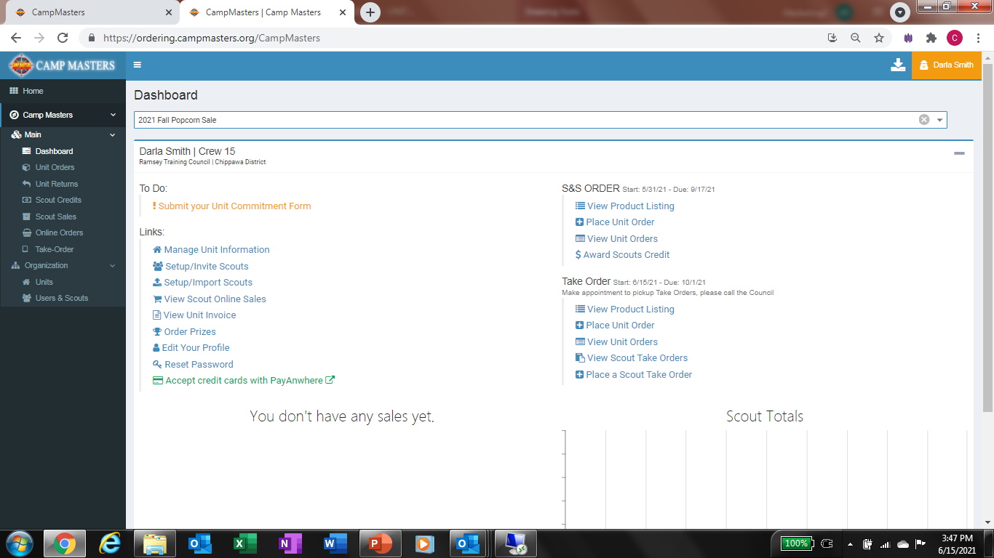
To Import Scout Roster, click on Setup/Import Scouts Under Links on the left
You will need to have an Excel Spreadsheet with Council Name, District Name, Scouts First Name, Last Name, Unit Type, Unit Number and Email address in separate columns. A Scout must have a UNIQUE email address, they cannot share an email with a Leader in the system or a Scout in another Unit. If siblings are in same Unit they can share an account under one email. Just list both Scout names in the First Name column. Example: Billy & Jared.

Slide 2
All Columns must be populated with information shown above except phone #. That is optional

Slide 3
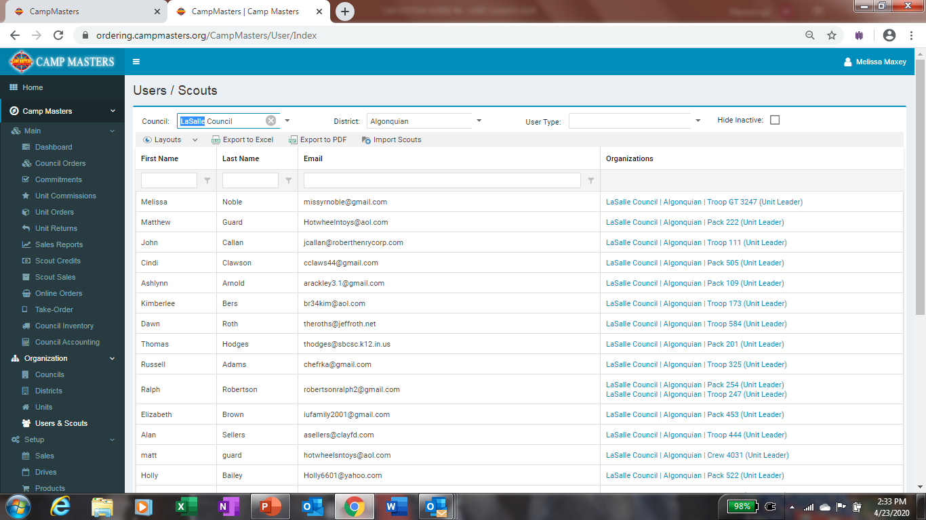
Click on Import Scouts

Slide 4
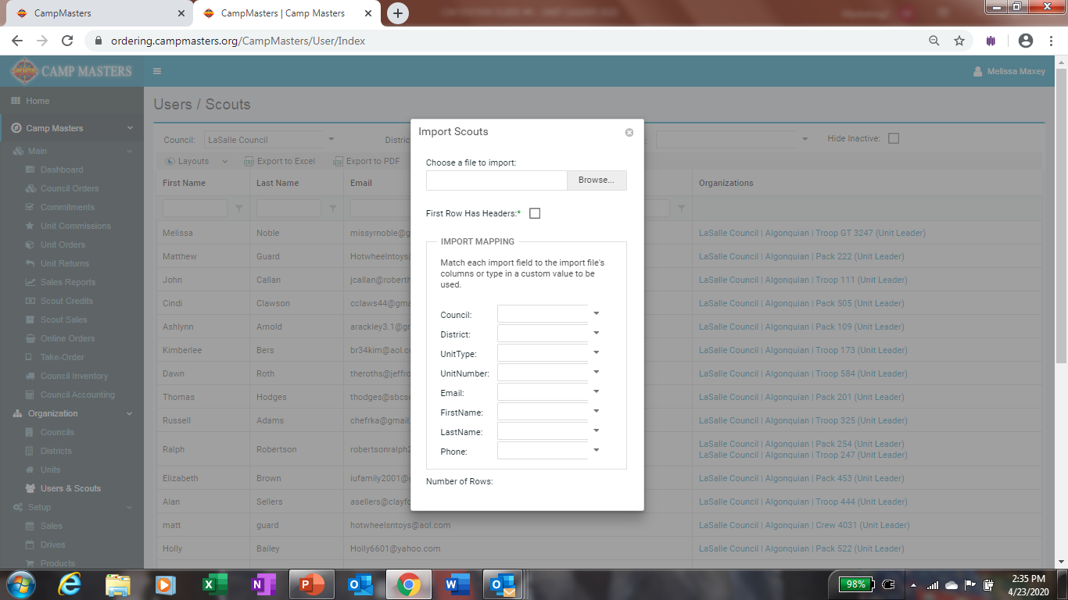
Once you have your excel spreadsheet set up and you have clicked on Import the box to the left will come up. Click on Browse to download your excel spreadsheet Roster of Scouts. Once Excel spreadsheet downloads, click on the box nest to First Row Has Headers. Then click on each arrow down and select the correct column from your Excel spreadsheet, continue until all information is populated. This will open up at the bottom, UPLOAD. Click on that to import.

Slide 5
Once your Scouts have been Imported, go back to your Dashboard. Under Links click on Setup/Invite Scouts. This will take you to your Units Users so you can send sign-on links to all Scouts. See next slide.

Slide 6
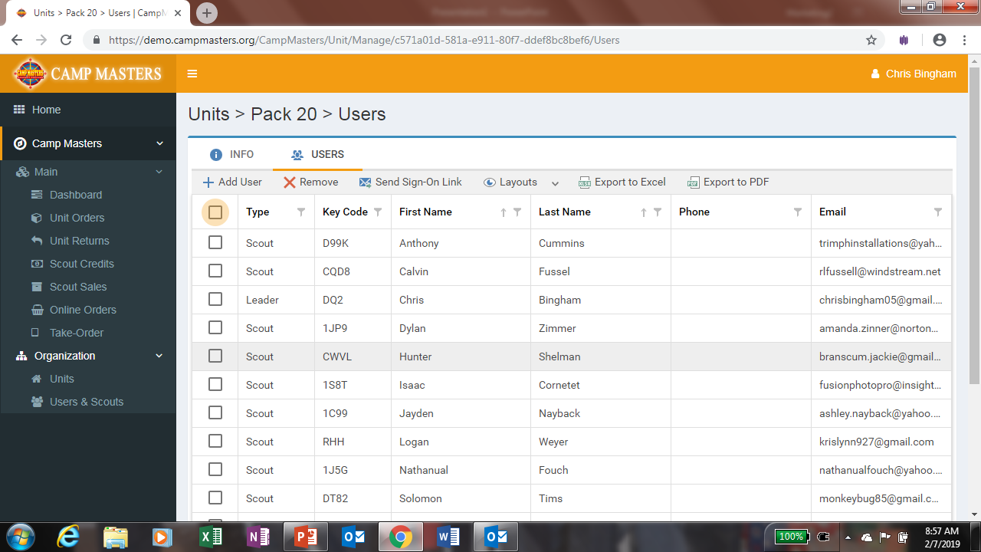
Click on Box to far left of TYPE. This will check mark all your Scouts turning the box Blue with Checkmark in it. You can uncheck any Leaders that have already been sent their link. Click on “Send Sign-on Link, then click OK when Message Box comes up.

