Slide 1
2023 SCOUTS POPCORN GUIDE
in partnership with
BSA logo, trade dress of Scouts BSA uniforms & the emblems & badges of rank thereon are trademarks of the Boy Scouts of America. Used with permission.

Slide 2
SUPPORT A SCOUT WITH POPCORN
The CAMP MASTERS online store has officially opened! What does this mean for your popcorn goals?
You can email your personal ordering link with friends and family.
You can host a Virtual Popcorn Party!
You can post on your and your parent’s social media accounts.
You can video chat with past customers, friends and family.
You can ask local businesses to support your sales.
You can build your own “popcorn squad” to promote your sale.
And so much more with the instructions found in this guide.
But FIRST … make SURE you set up your Scout Account at CAMPMASTERS.ORG

Slide 3
REGISTER / UPDATE YOUR SCOUT ACCOUNT
Click here to visit Ordering.CAMPMASTERS.org - This will bring you to the login screen.
Click the blue button:
On the registration form, choose …
Scout if you have your own email
or Parent / Guardian if using their email
Select Your Age …
Complete the form and submit. If you see a message that says you’ve previously registered, skip to step 8. Otherwise, go to step 6.
Head over to your email inbox and look for the email titled:
CONFIRM YOUR EMAIL TO COMPLETE YOUR REGISTRATION
Click on the link in the email.

Slide 4
ALREADY REGISTERED WITH CAMP MASTERS?
If you see this message, there are a few more steps. Otherwise, you can skip to the next page.
If you’re with the same Unit, click the green Sign In button. If you’ve changed Units (or are unsure what Unit you are assigned to in CAMP MASTERS), Click the blue Register button.
If you clicked the blue Register button, you’ll need to search for your Unit. Type your Unit, State or Council name to find your correct Unit.
Select your correct Unit from the dropdown list and click Register.
Head over to your email inbox and look for the email titled:
CONFIRM YOUR EMAIL TO COMPLETE YOUR REGISTRATION
Click on the link in the email.

Slide 5
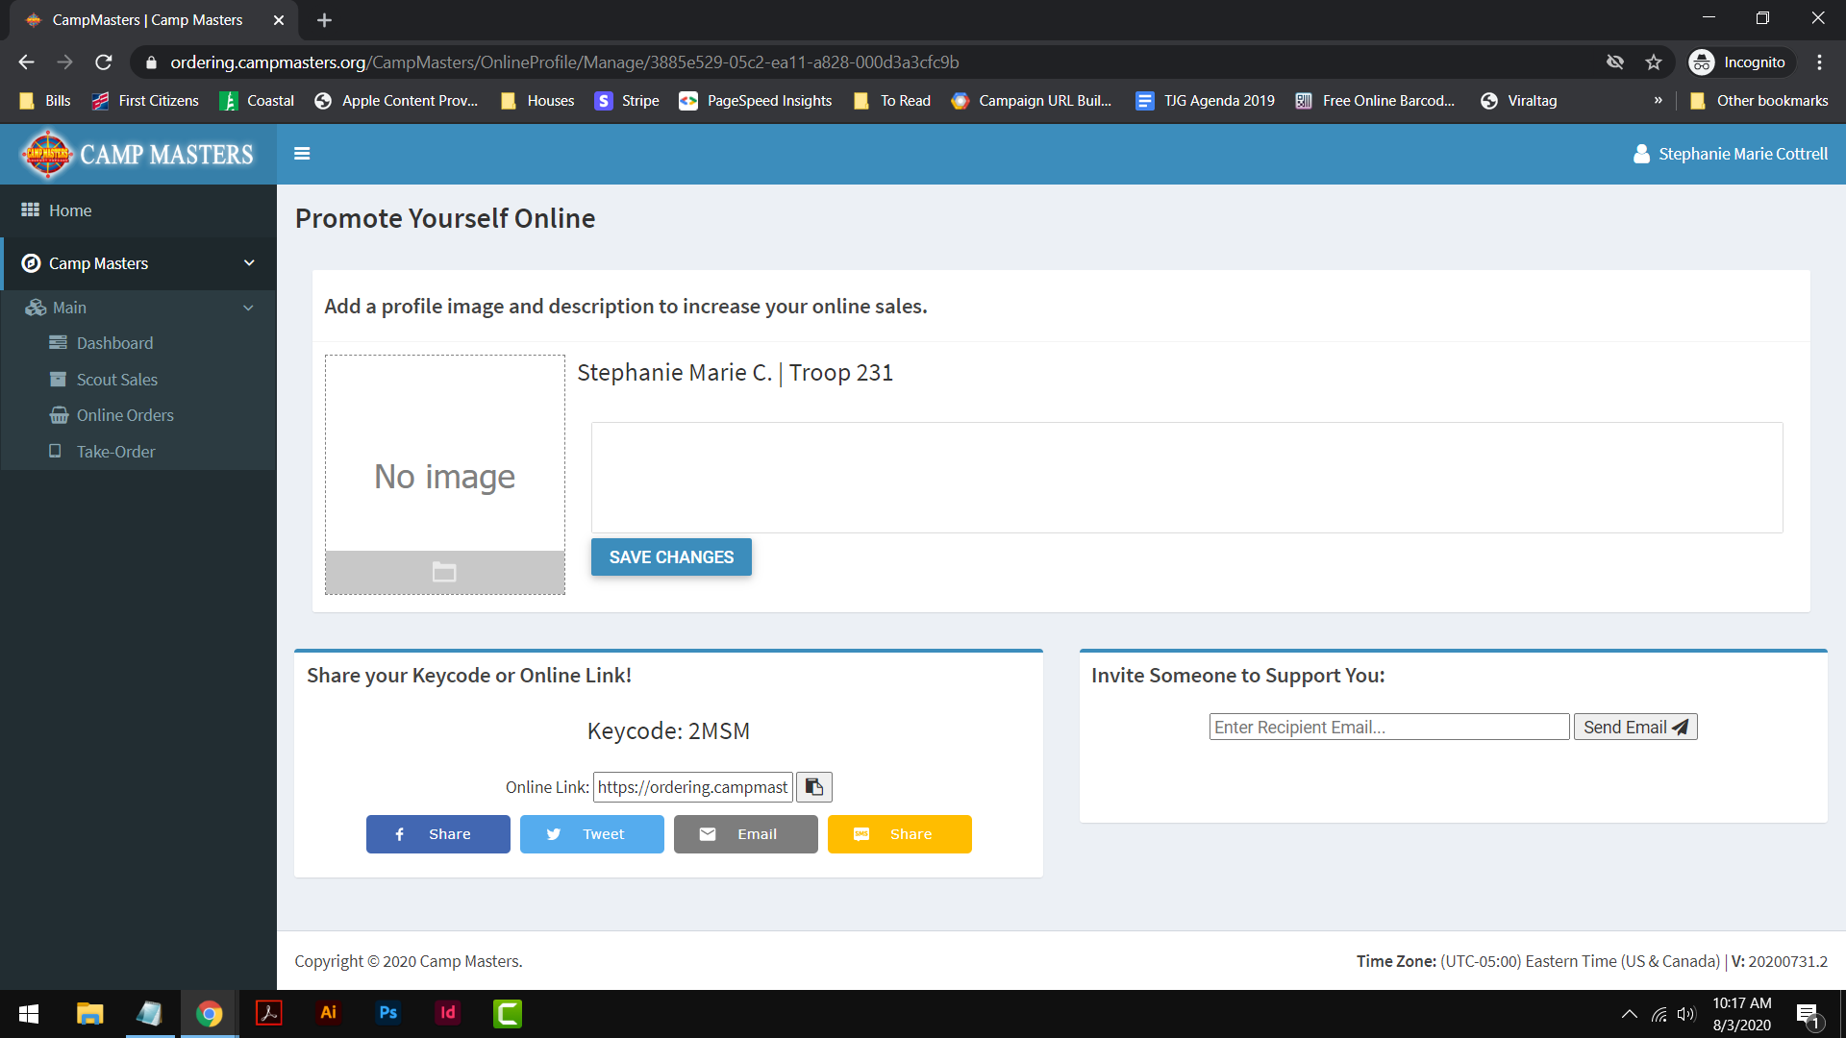
TIME TO COMPLETE / UPDATE YOUR SCOUT BIO
From the Dashboard, click on Promote Yourself Online under the LINKS menu.
Click on the folder icon to add your picture. If you don’t have one, take one outside with a nice background using a phone or digital camera. Choose your picture file to upload. Then click the submit button. You’ll receive a green confirmation banner once the changes have saved.
Click Save Changes and your profile image is all done. Now let’s create your Scout Bio.
1
3
2

Slide 6
TIME TO COMPLETE / UPDATE YOUR SCOUT BIO
In the empty box below your name, click in the box to begin typing. This is your introduction to potential supports so be sure to make a great first impression. Here’s a template to get started. Hi and thanks for visiting my popcorn page. My Scouting adventures began at age _____. I became interested in Scouting because _______________________________________________________________________.
My biggest accomplishment / adventure so far is ____________________________________________________.
I’m currently fundraising to earn my own way to ____________________________________________________. Your popcorn purchase here is a donation that helps me and my fellow Scouts ________________________________________________________________________________________________________.
Your support means very much to me because _______________________________________________________________.
You’ll help me out today, won’t you?
Click the Save Changes button and you’re done! Now it’s time to promote your popcorn sale.
5
6

Slide 7
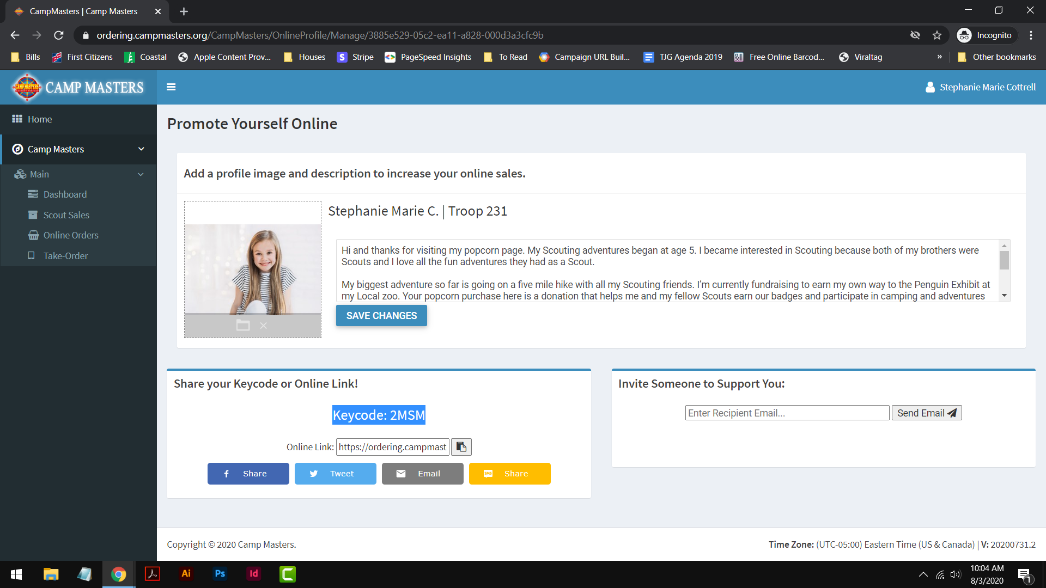
PROMOTING POPCORN | HANGERS & CARDS
Parents: check with your Unit Leader or Popcorn Kernel for specifics on acquiring these items.
HEY SCOUTS! It’s time to let your neighbors know IT’S POPCORN TIME! And to keep everyone safe, you can use these door hangers provided by your Unit.
Add your name and other information to the front of the door hanger or card with a dark marker.
Get your personal Key Code (found by clicking “Promote Yourself Online” from your CAMP MASTERS dashboard).

Slide 8
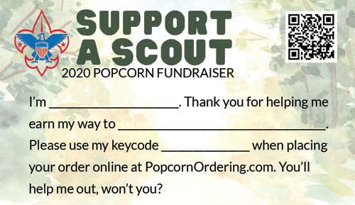
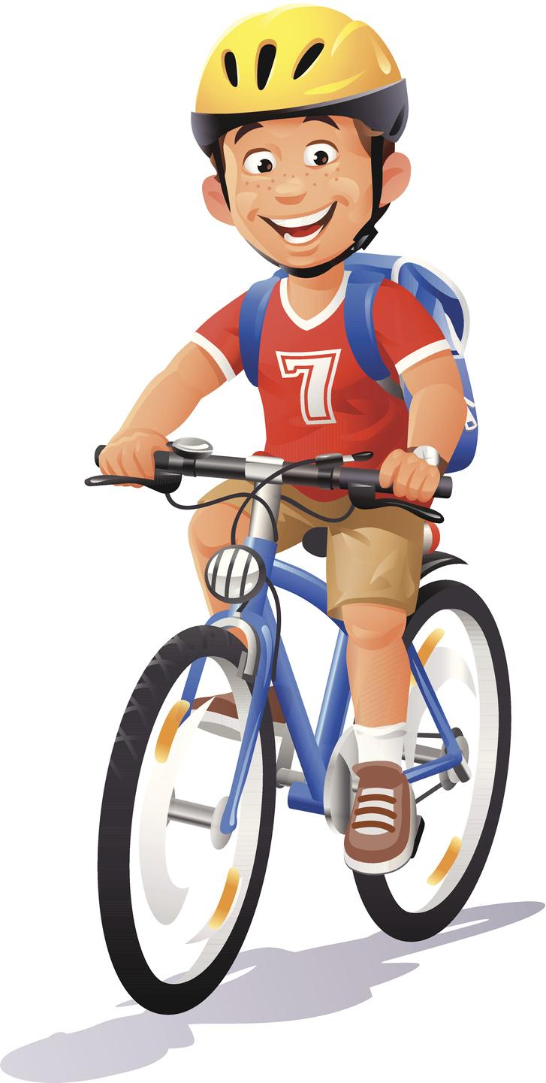
PROMOTING POPCORN | HANGERS & CARDS
Add your Key Code to the card plus a phone number on the back of the door hanger with a dark marker. Your Unit Leader will have a personalized version of the door hanger with available products and images added.
Now you’re ready to pass out these hangers and cards.
Hangers are great on door knobs or use a rubber band to attach on mailbox flags of houses in your community.
Ask the property manager if you can leave hangers or cards in the mailboxes / doors in apartments or condo communities.
Remember to be respectful of others property by using sidewalks and gaining permission before distributing.
Deliver to local businesses (like gas stations) and ask them to post or leave a stack of cards at the checkout.
Ask a local realtor to help by giving a hanger or card to their clients who recently purchased a home in the area.
Post to bulletin boards or other public announcement spaces in your community.
PRINT YOUR OWN HANDOUT CARDS HERE: VistaPrint (100 for $15)

Slide 9
PROMOTING POPCORN | SOCIAL MEDIA POSTS
Let’s Connect Online! It’s time to let your family, friends and followers help support your popcorn sale. Make a post to your social profile or send a direct message to ask for their support.
Make sure you have your Key Code or Online Link from CAMP MASTERS.
Did you know? You can also share to Facebook and Twitter right from within your CAMP MASTERS profile! (click the icons below your Key Code).
CAMP MASTERS is providing the social content for you here. Check back often as new post templates are added throughout the sale.
Be sure to ask others to share your message on their own accounts too! We’re all ‘Supporting a Scout’ together.
FUN TIP: You can also use this email template to send direct or private messages using your social media account!

Slide 10
PROMOTING POPCORN | SEND EMAILS
Make a list and send it twice! Email is a great way to ask friends and family personally for their support of your Scout. There are multiple ways to make a connection!
Make a list of friends and family you think will support you in the popcorn sale. Try and list as many as you can think of in 5 minutes.
Then, you can send an email right from your CAMP MASTERS Dashboard by clicking the gray button OR by using the quick send tool to the right.
You can also Copy your Online Order Link and send a personalized message from your inbox. CAMP MASTERS offers a great template to get you started.
After a few days, send the follow up message to anyone you haven’t heard from. Sometimes people get busy and forget. Or don’t have time to order right when you email them. It’s OKAY to gently remind them of your request for their support.

Slide 11
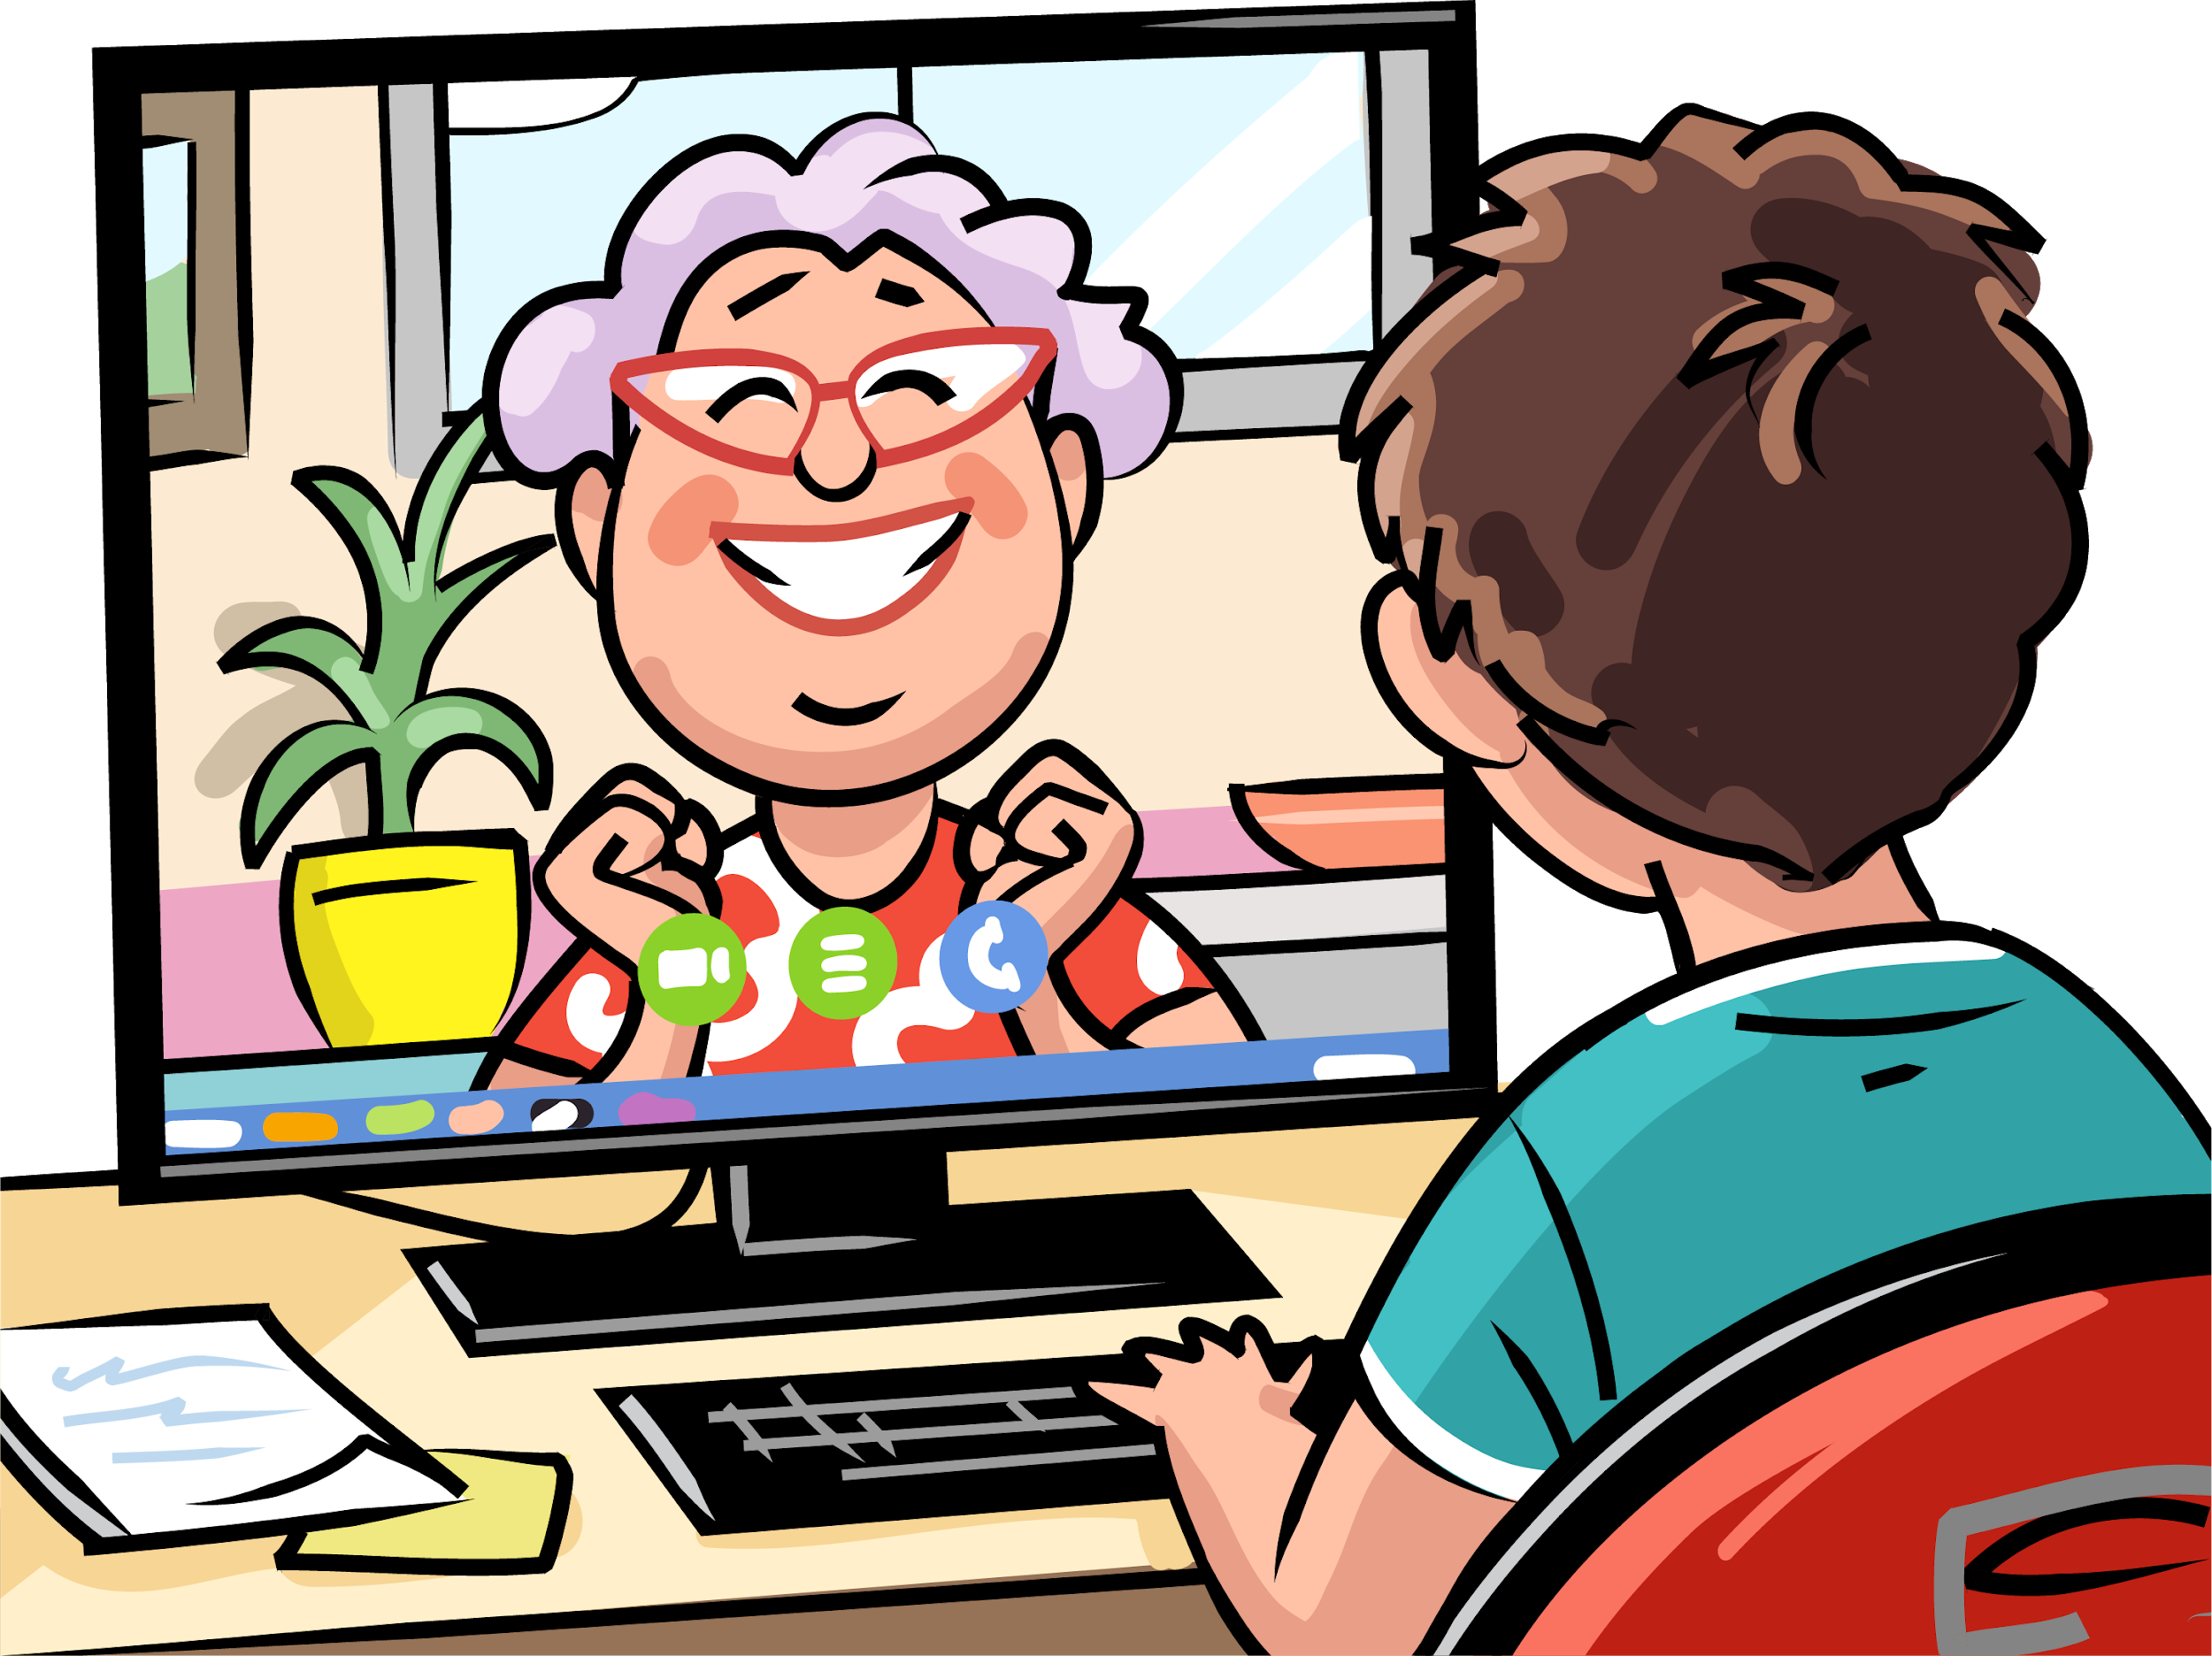
PROMOTING POPCORN | VIDEO CALLS
Connect and catch up! Some of your friends and family will appreciate you asking for their support in person. It’s kind of hard to do right now. But you can easily connect using Facetime, Google Meet, Zoom or one of the many other video call platforms out there.
Each of the platforms above are free to use, but will require a phone or online account.
Once you’ve set up your account, send an email invite to the other person with instructions on how to join you. (Note: these can be copied from the platform in most cases.)
Connect with them on the platform and let them know it’s POPCORN time!
Ask for their support using your CAMP MASTERS popcorn script.
You can give them the option to order Online or complete a TAKE ORDER for them using the CAMP MASTERS app. Note: Take Orders will be delivered by you to the customer. Online orders ship Free to their door.

Slide 12
PROMOTING POPCORN | POPCORN PARTIES
Bust out the popcorn for PARTY TIME! We may not be able to get together, but that doesn’t mean we can’t still host a rockin’ P-A-R-T-Y. Invite your friends and family to join you for a virtual popcorn party by using a video conference platform like Google Meet or Zoom.
Make a guest list for your party and send out the invitations. Don’t forget to include the link to your virtual party room!
Get prepared to go live by grabbing your Take Order form and securing any show-n-sell products you want on-hand from your Popcorn Kernel. It’s good to have at least your personal favorites on hand to show off to your guests. During the party:
Introduce yourself
Thank everyone for coming
Talk about what Scouting means to you
Introduce each of the available products + Give a description + Show the popcorn + Share what you like about it + Encourage them to ask questions
Close by asking each person for their support. You can take orders live or reach out to them after the party by email or phone.

Slide 13
PROMOTING POPCORN | POPCORN SQUAD
CREATE YOUR POPCORN SQUAD! Ask your friends, family and neighbors to help spread the word about your popcorn sale!
Make a list of everyone you can think of in 5 minutes who would happily tell others about your popcorn sale.
Reach out to them personally and ask for their support. Here are just a few of the ways they can serve on your popcorn squad:
Distributing cards or door hangers where they live and work.
Sharing posts on their social media accounts.
Hosting a virtual popcorn party with you.
Emailing your online ordering link to people they know.
Asking their boss and co-workers to Support a Scout this year.
Think of fun challenges or ways you can help your popcorn squad celebrate their hard work and contribution to your popcorn fundraising success!

Slide 14
PROMOTING POPCORN | LOCAL BUSINESSES
ASK LOCAL BUSINESS OWNERS FOR THEIR SUPPORT! The people who own a business in your town or county are always looking for ways to give back. Give them a call and let them know you’d like their support in the popcorn sale.
Research local businesses within your town that you think would be a great popcorn partner.
Ask for the owner or manager when you call. Be sure to introduce yourself by name and give the reason for your call. Hi! My name is Caleb and I am a Scout with local Troop 321. I’m calling to speak with the owner about supporting my Unit this fall through our popcorn fundraiser. It’s helping me earn my own way to __________________. Do they have five minutes to talk with me?
If they aren’t available, leave a message asking them to call you back. When you do connect with them, let them know:
What you’re doing - fundraising by selling popcorn
Who it supports - your local Scouts
Why it matters - why Scouting is important to you
And how they can help
Purchasing popcorn for themselves, their clients or employees
Displaying your Scout Card at their location
Displaying a window sign at their location
Promoting the popcorn sale to their personal contacts

Slide 15
PROMOTING POPCORN | KEEP A LIST
BEFORE THE SALE ENDS! Keep a list of everyone who ordered popcorn from you throughout the sale this year. Here’s how it can help you sell more popcorn.
Add the date and what they ordered from you. In a few weeks, send a quick email follow up and see if they need to restock. Our yummy popcorn goes fast; and only comes around once a year. Make sure your friends, family and neighbors don’t run out!
Reach out to everyone on your list a few days before the sale ends to capture any final orders they might want to make. This can be for take orders or online orders.
PRO SELLER TIP!
Save this list and use it to kick off next year’s popcorn sale. You’ll have an instant customer base to start fundraising with. And you’ll be able to let them know what they ordered and enjoyed last year.

Slide 16
BE PREPARED FOR YOUR & OTHERS SAFETY
Every Scout must follow all guidelines outlined by their state and local health department or other state and local authorities, including the Boy Scouts of America. Check with your Council on what’s required.
RECOMMENDED GUIDELINES FOR ALL SCOUTS
Limit exposure to Coronavirus and check your temperature before coming into contact with others.
Wear gloves to minimize the spread of germs. Watch this video to see how quickly they can spread.
Always wash your hands minimum of 20 seconds. (Refer back to the germ video).
Use hand sanitizer regularly, especially after personal contact.
Clean any surfaces frequently with a disinfectant wipe or hand sanitizer.
Do not shake hands with customers and maintain social distance.

