Slide 1
Venturing program
Shannon McCullen
April Roundtable

Slide 2
What is Venturing?
Venturing is a branch of Boy Scouting focusing in high adventure
Venturing seeks to provide positive experiences and help young adults become responsible and mature

Slide 3
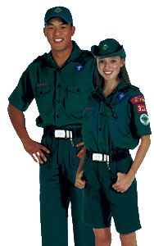
Who can be Venture Scouts?
Young men and women aged 14-20
You can join if you are 13 and have completed 8th grade
When you turn 21, you can register as an adult leader

Slide 4
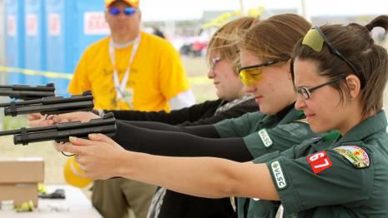
What can Venture Scouts do?
Hunting
Pistol Shooting
Large Bore Rifle Shooting
Snowmobiling
Dirt Biking

Slide 5
What can’t Venture Scouts do?
Skydiving
Paintball (shooting at others)
Parasailing
Bungee Jumping
Fireworks

Slide 6
How is Venturing different?
Crews tend to have a focus area
Youth in Venture Crews can be registered adults in Boy Scout Troops or Cub Scout Packs
Crews are almost completely run by the Crew officers and youth

Slide 7
Where is Venturing in Vermont?
There are current crews in Essex, Milton, Barre, Benson, Jeffersonville and Eden
A crew is being started in Colchester
Several troops have Venture patrols within their troops

Slide 8
How has the Venturing program changed?
The program was completely redone in 2015
There are now four ranks: Venturing, Discovery, Pathfinder, and Summit
The Ranger Award can still be earned
Boy Scouts can earn Eagle in the crew as long as they have completed through First Class in a troop
The Ranger Award still has core and elective requirements

Slide 9
What do leaders need to know?
All Venturing leaders must complete both Youth Protection and Venturing Youth Protection
If there are male and female scouts at an event there must be a male and female leader

