Slide 1
YourTown Scout Troop ###
Information Night

Slide 2
What is Scout BSA?
A Program for all youth 11-17 years old
Adventure
Service
community engagement
leadership development
path toward earning Scouting’s
highest rank, Eagle Scout.

Slide 3
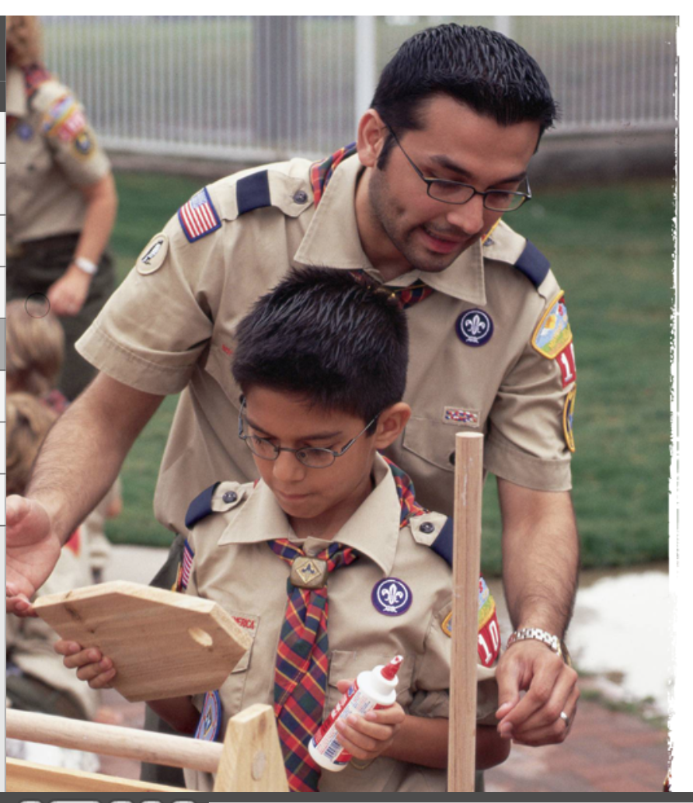
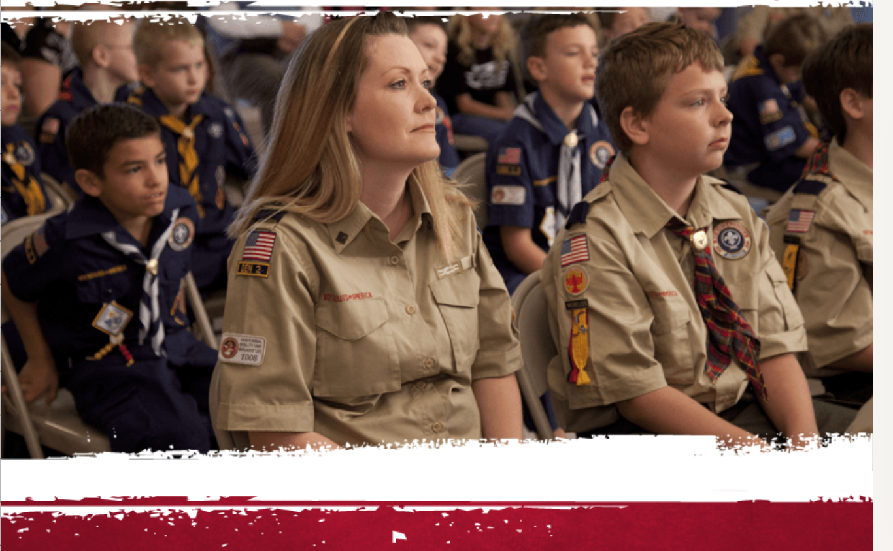
WHAT IT PROVIDES FOR PARENTS
Opportunities
Unlock a world of discovery around them and forge a path for their future
Connect with others
Bring the family together
Positive learning environment

Slide 4
Your Troop pictures

Slide 5
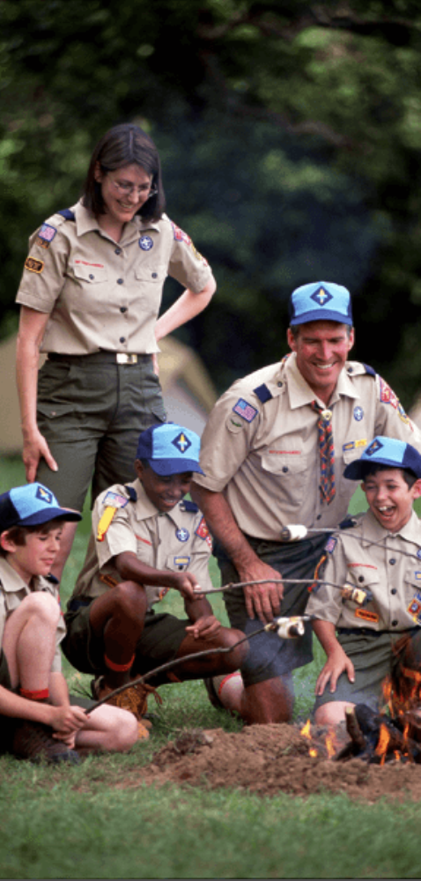
Weekly Troop Meetings
Your Troop pictures

Slide 6
Scout Life
Scouting magazine just for kids
District & Council Events
Summer resident camps
Leader training and support

Slide 7
Program
Boy Scouts of America has a specific advancement plan. This program is designed to encourage Scouts to participate in a progressive series of learning experiences. The plan also provides a specific means of measuring and recognizing achievement in these experiences. There are four steps that a Scout must go through to advance.
Learning by doing
Being Tested

Slide 8
Finance
Registration Fees
Uniform and Book
Dues
Popcorn Sale
Family Giving – “Vermont Character Co-op”

Slide 9
Troop Website and Facebook

Slide 10
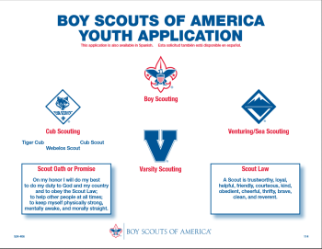
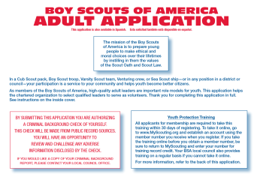
Registration
To register youth:
Completed form tonight
Pay Troop Dues - $XX
(Includes registration, insurance, Scout Life subscription
Troop provided patches, neckerchief and slide)
To register adults:
Completed form tonight
Take Youth Protection Training online
Troop covers costs of registration, insurance, training and Scouting Magazine subscription

Slide 11
Thank you!
Any questions?
Scoutmaster Name
troop123youremail@gmail.com

Slide 12
Your Troop pictures

