Slide 1

YourTown Cub Scout Pack ###
Information Night

Slide 2
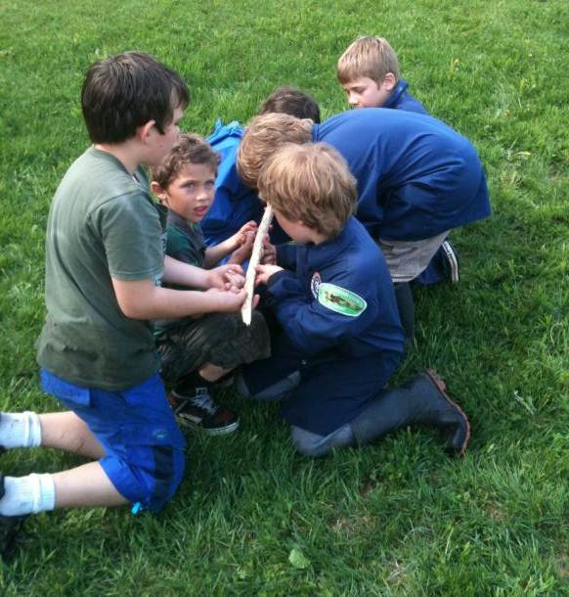
What is Cub Scouting?
Program for all youth in grades K through 5
Builds character
Teaches citizenship
Strengthens families
Tons of FUN!!

Slide 3
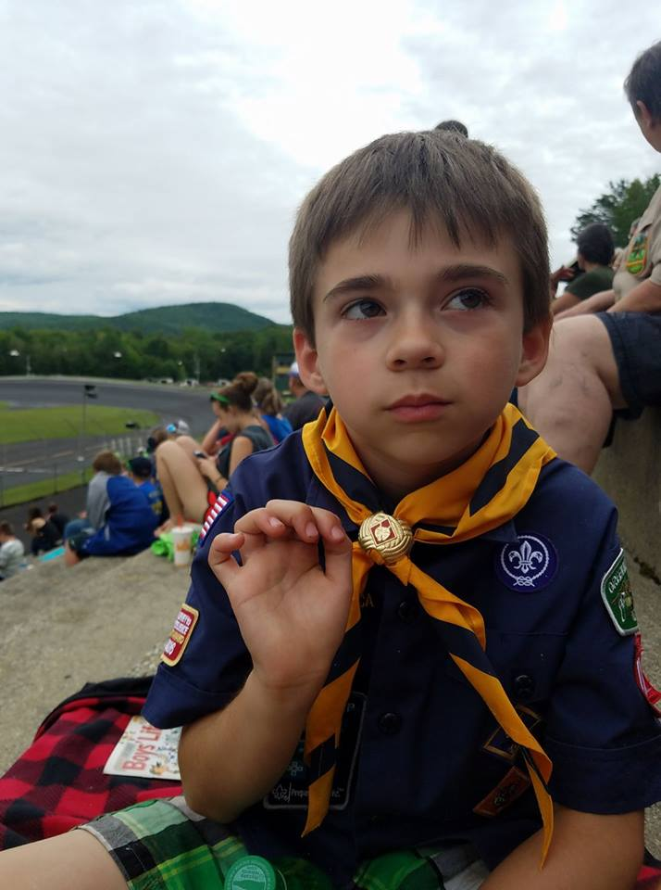
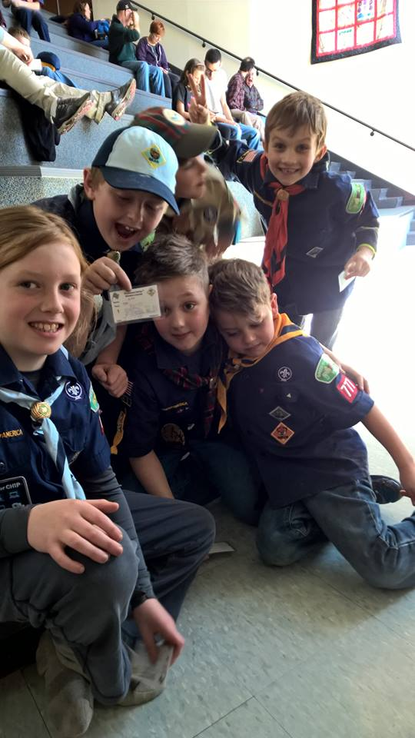
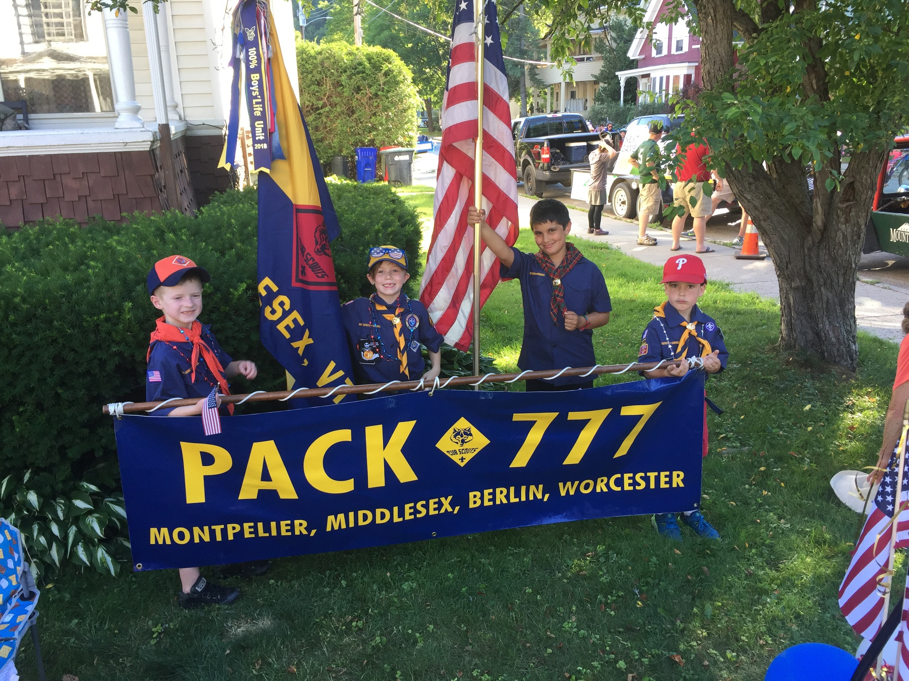
WHAT IT PROVIDES FOR YOUTH
Opportunities
Make new friends
Master new skills
Recognition and praise
Just have FUN!

Slide 4


WHAT IT PROVIDES FOR PARENTS
Opportunities
Bring the family together
Help your child develop
Connect with others
Positive learning environment

Slide 5
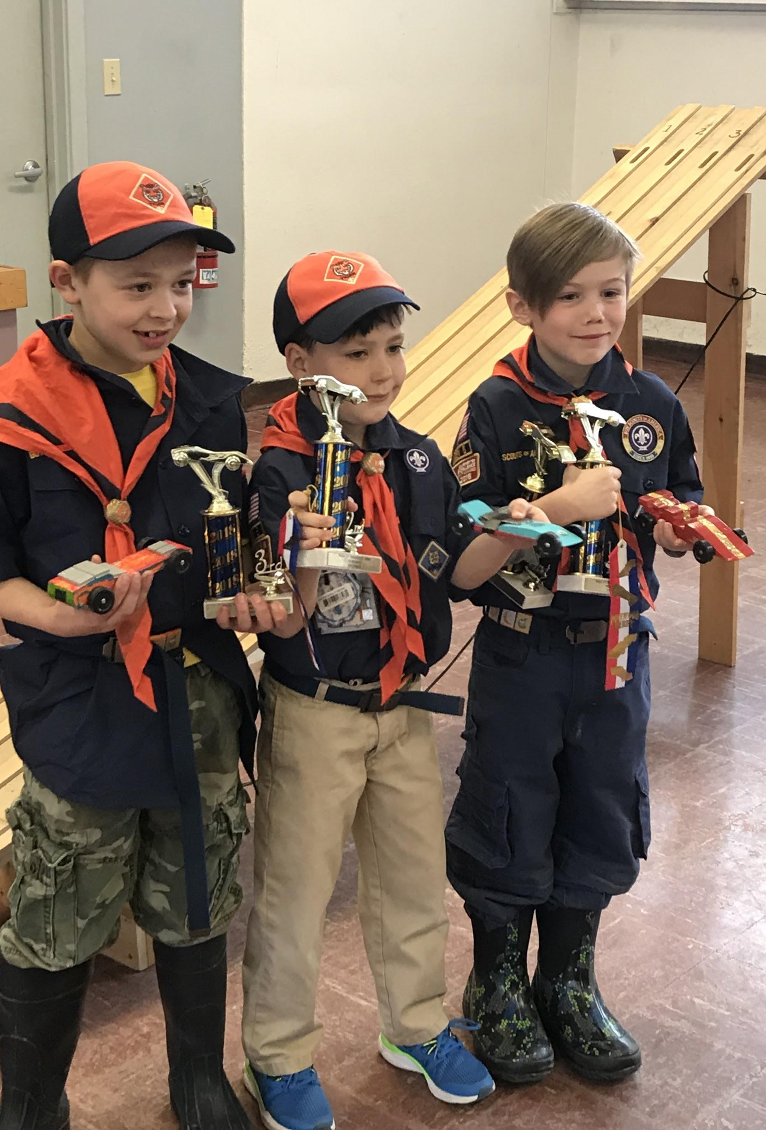
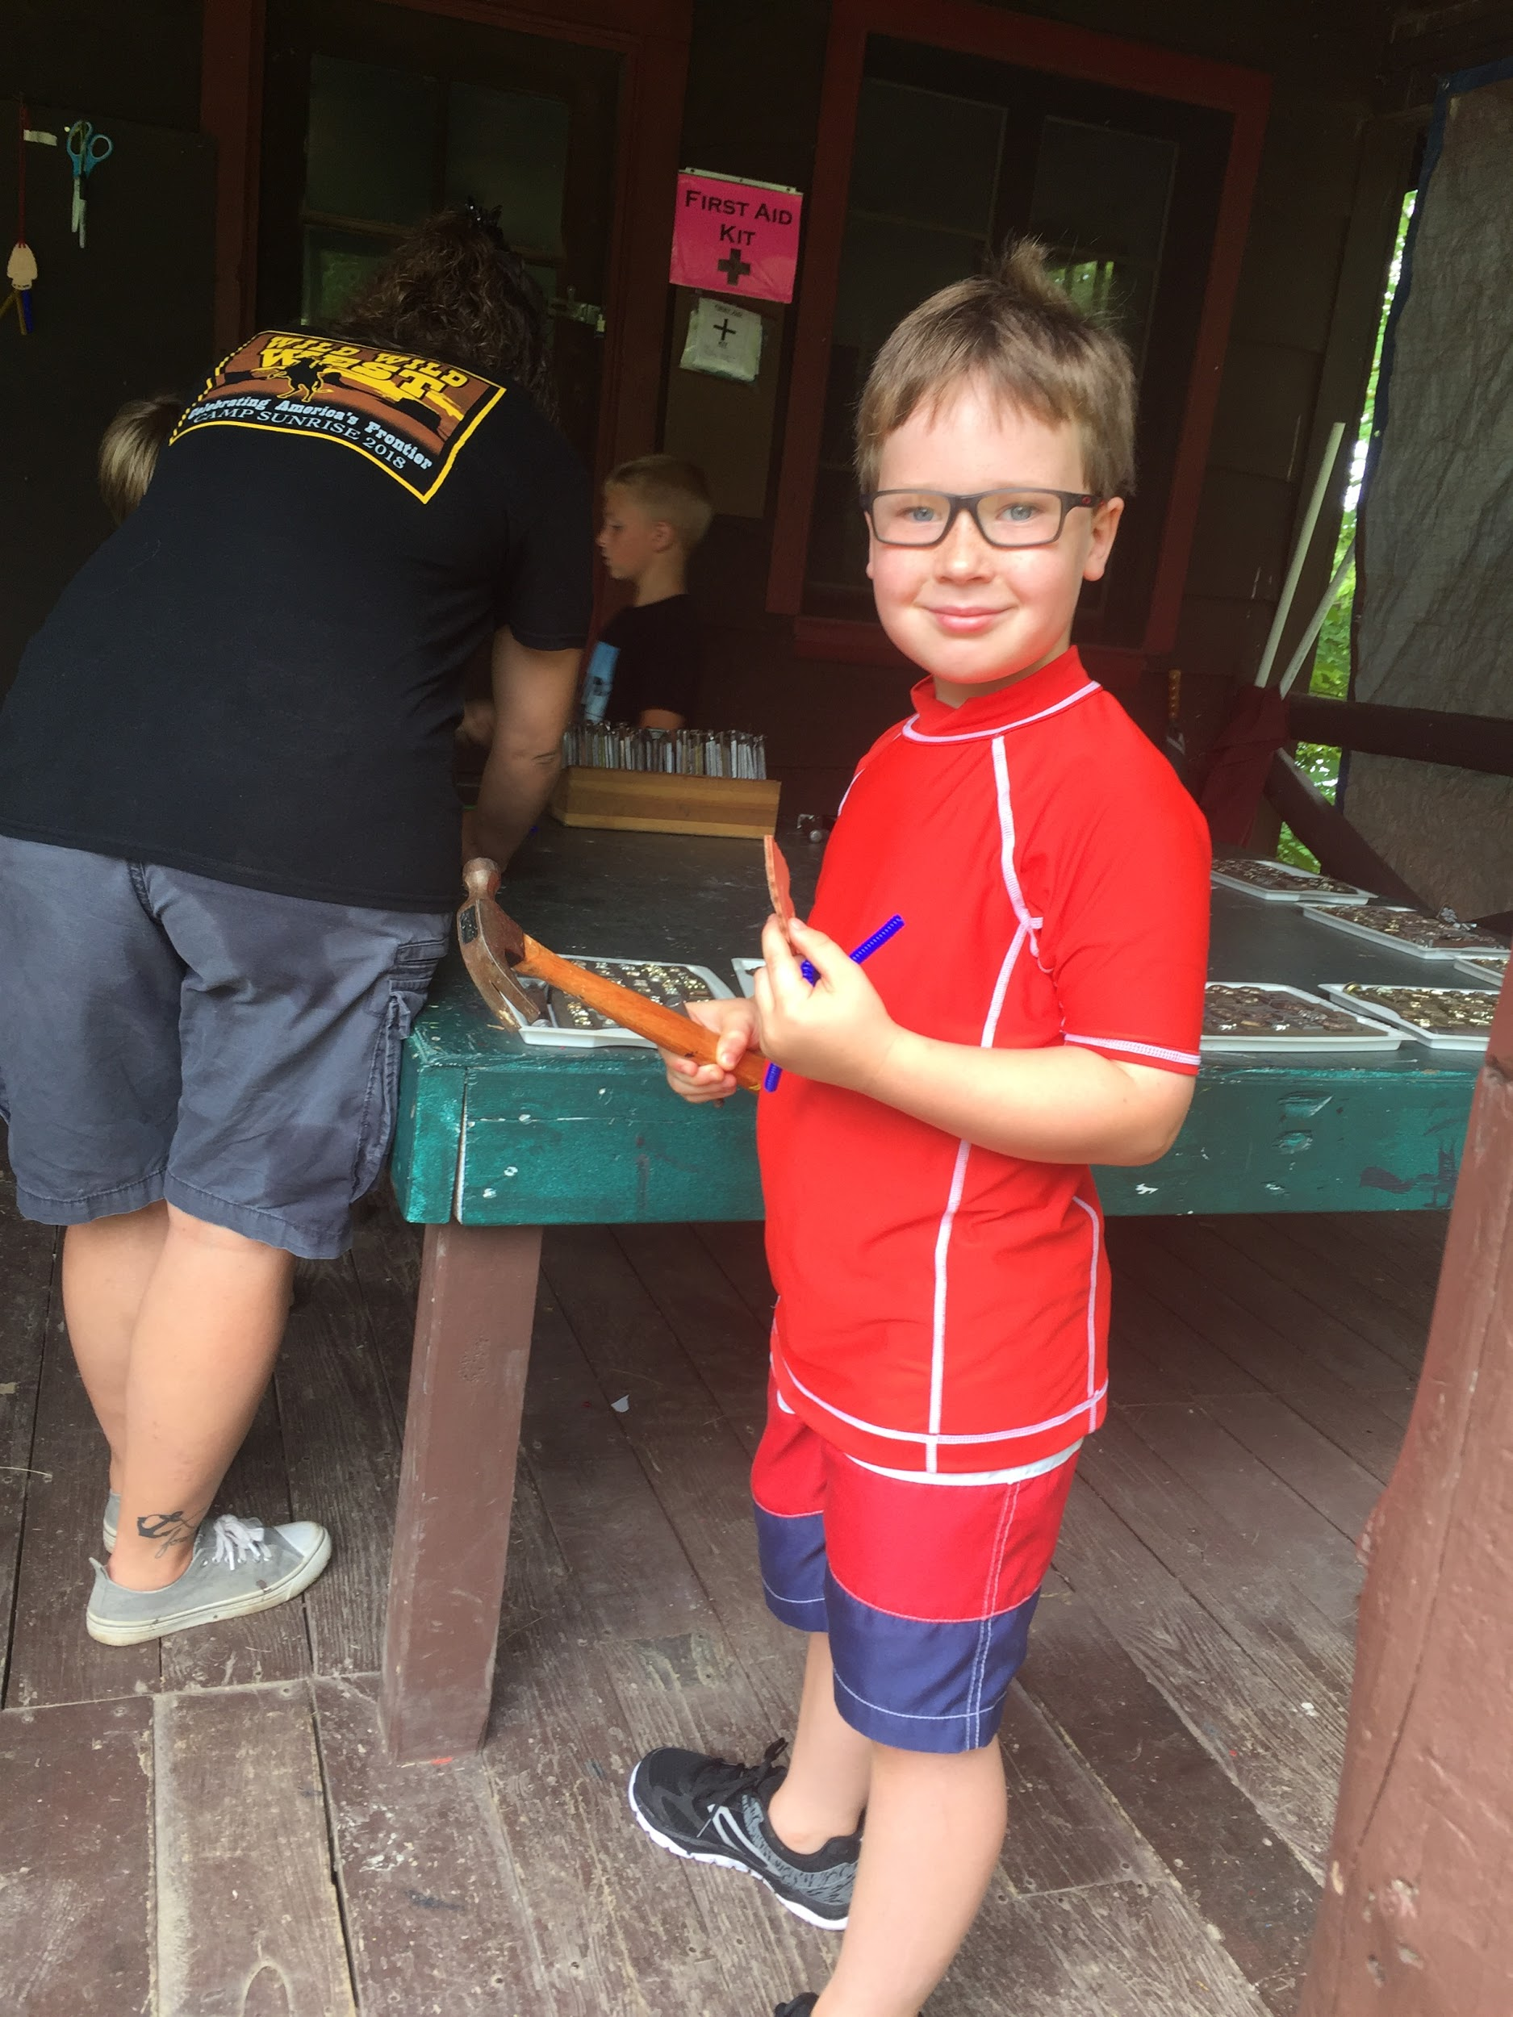
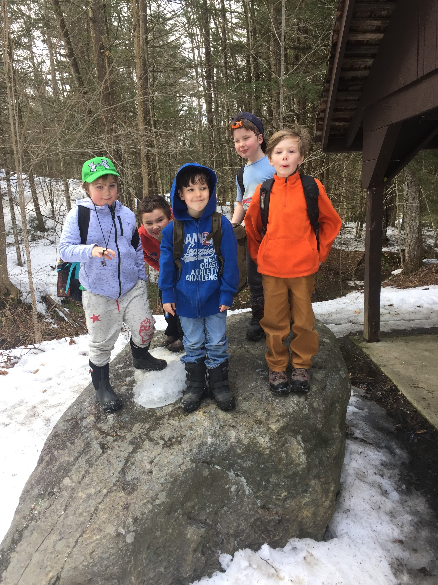
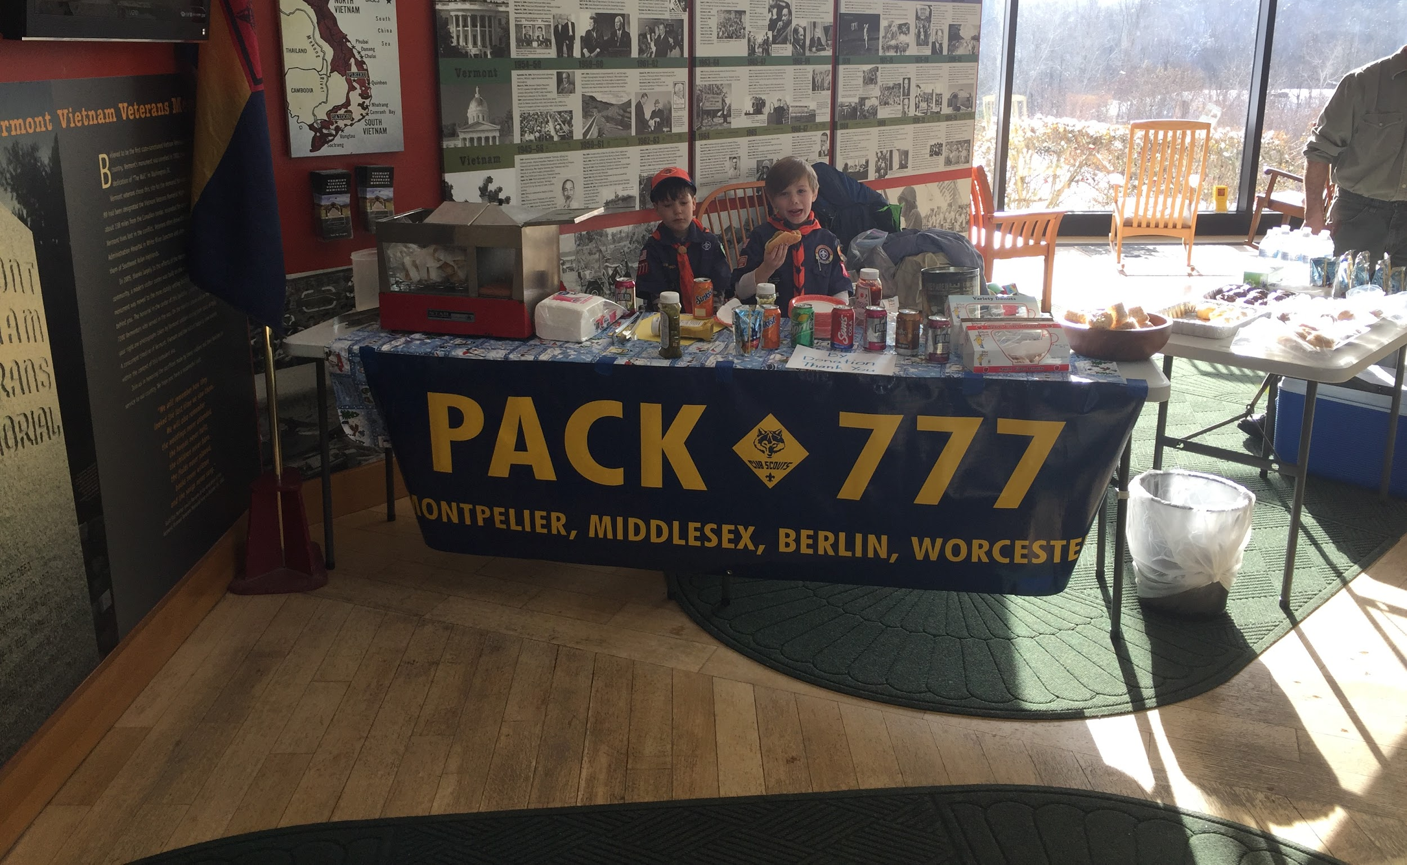
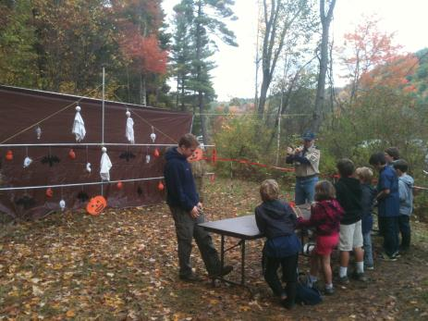

Slide 6
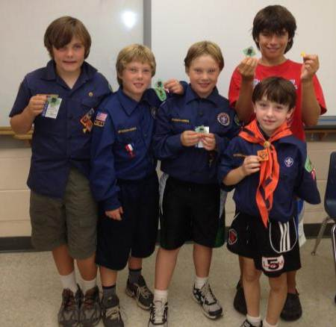
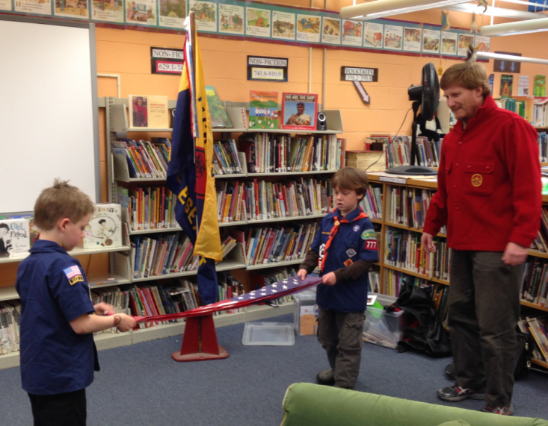
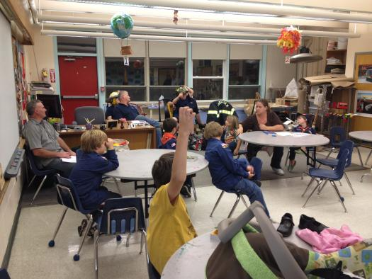
How Does it work?
Monthly Pack Meetings
  All youth and families
  Recognize youth’s Achievements
  Participate in an Activity

Slide 7
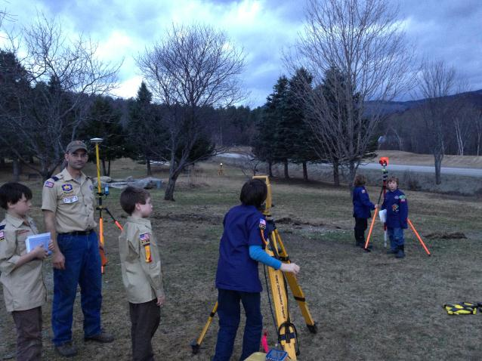
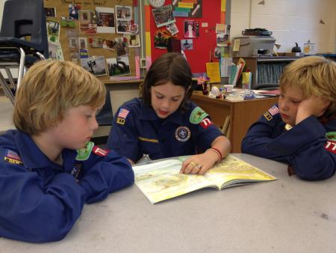
Weekly Den Meetings
  Small groups, all same age / grades
  Do activities or field trips
  Games & fun

Slide 8


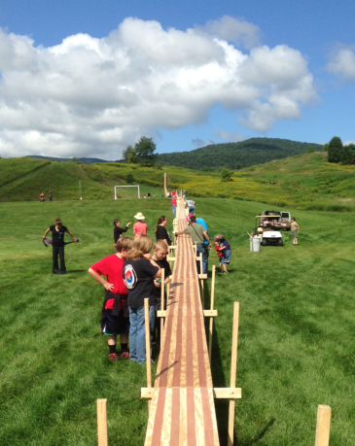


Scout Life
  Scouting magazine just for kids
District & Council Events
  Day and resident camps
  Pinewood Derby
  Leader training and support

Slide 9
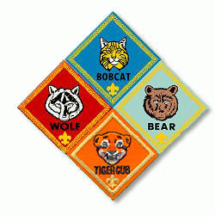



Advancement
Age-based rank
  Assigned by grade
Awards and badges
  Connecting efforts and success
Recognition
  Celebrating achievement
  and building self-confidence

Slide 10
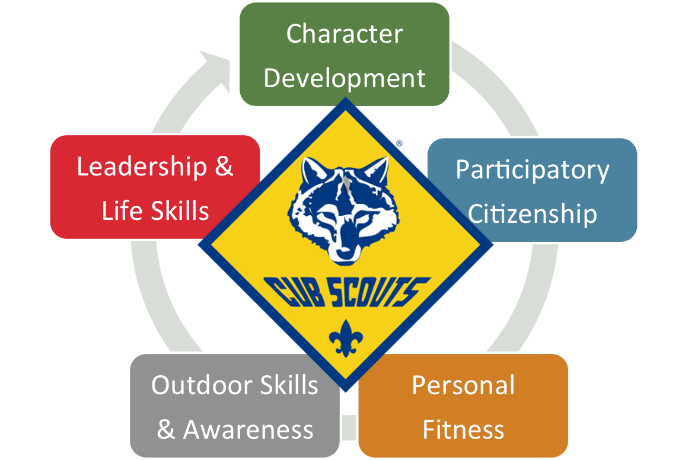






Program
Adventure Based
  7 adventures to earn rank
  Required + elective
  Theme-based experiences
Belt loops & Pins

Slide 11
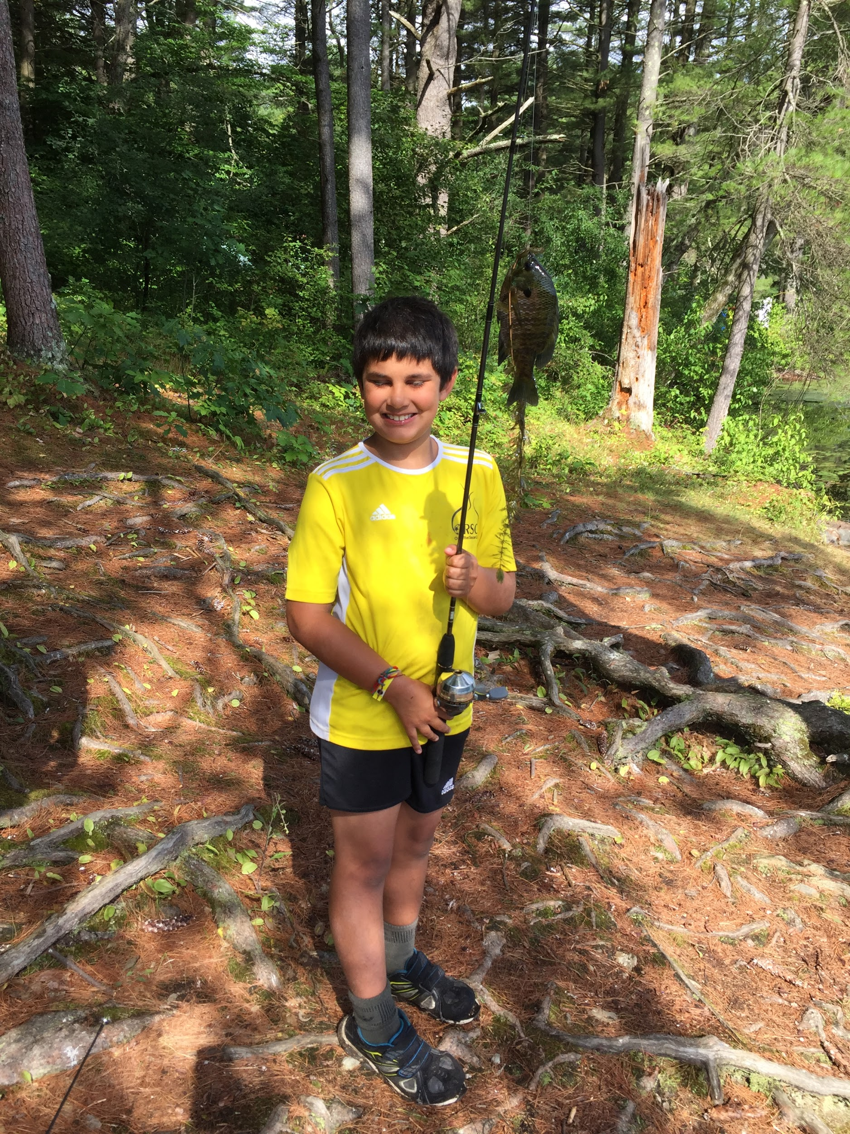
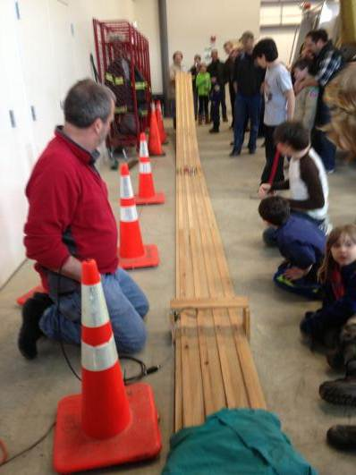
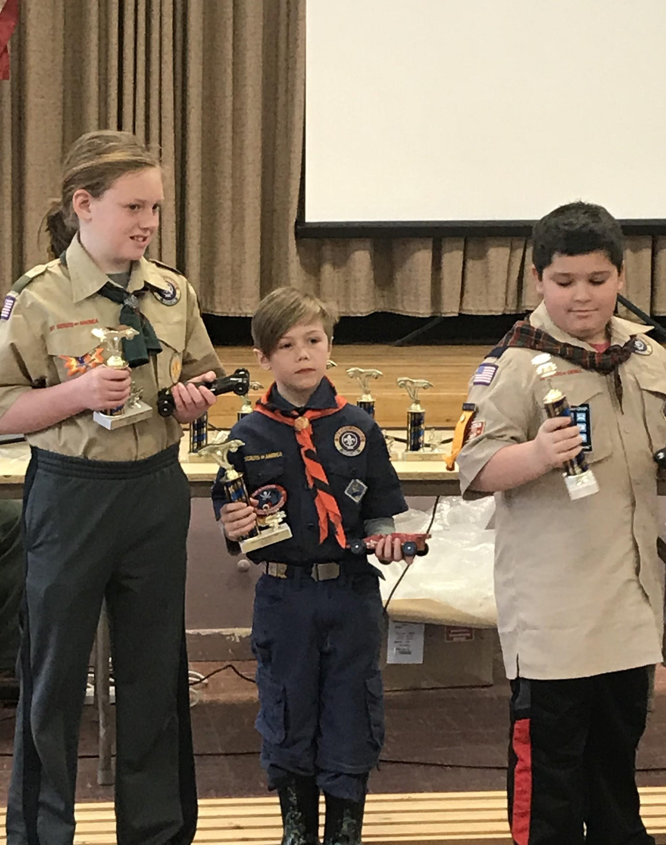
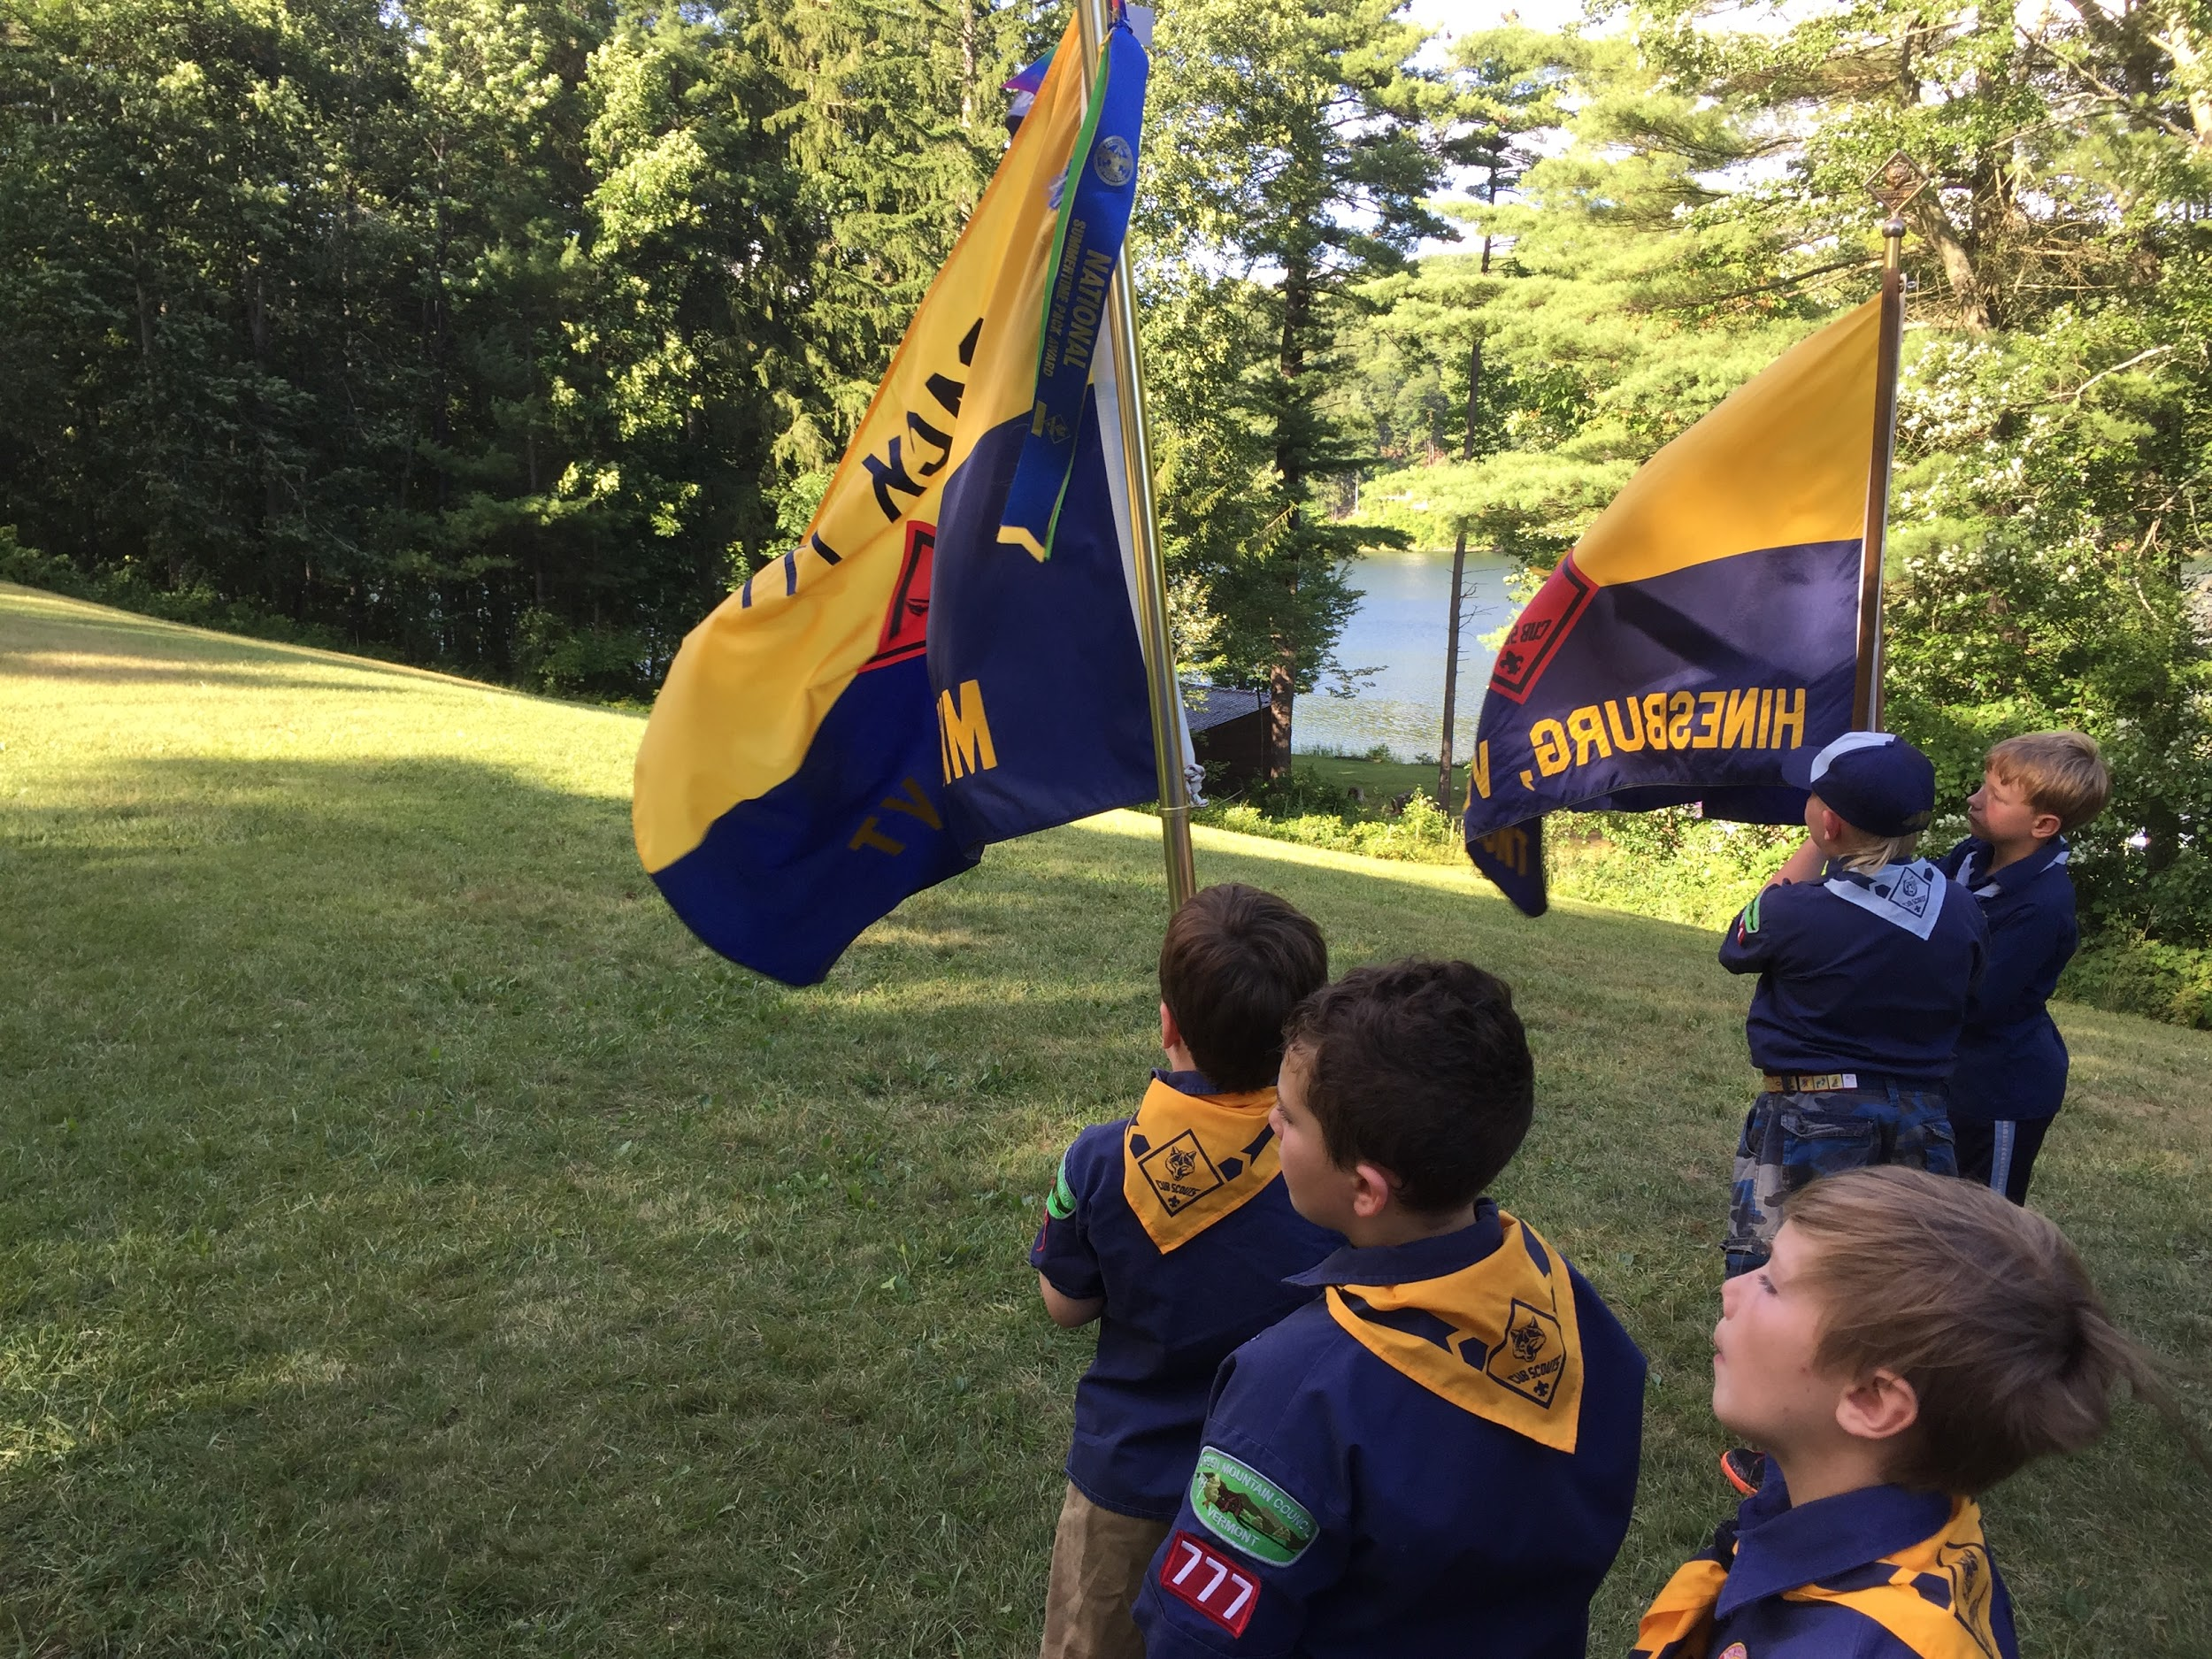

Slide 12
Pack Organization
Vermont Council:
  Green Mountain Council
Pack ### Charter Organization:
  Middlesex Vol Fire Department Auxiliary
Pack Committee’s Role:
  Administrative and support of Pack
Many parent roles available:
  Assistant Den Leaders
  Committee Members
  Treasurer
  Event Planning Committees
  Parent Helpers

Slide 13



Finance
Registration Fees
Uniform and Book
Dues
Popcorn Sale
Family Giving – “Vermont Character Co-op”

Slide 14
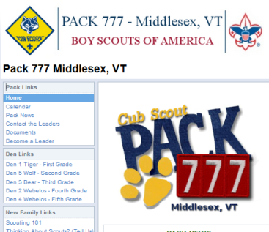
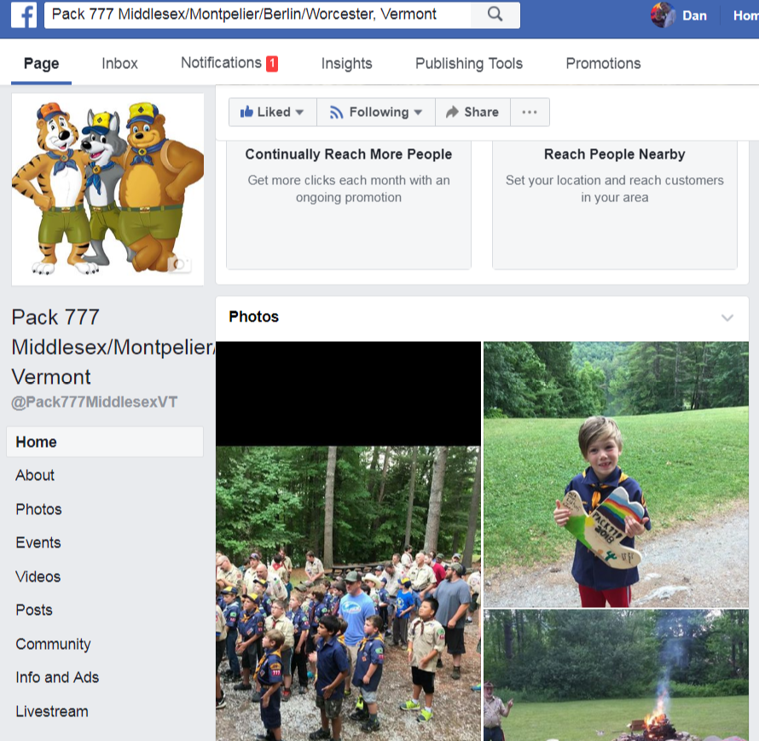
Pack Website and Facebook
https://sites.google.com/site/pack777middlesex
https://www.facebook.com/Pack777MiddlesexVT

Slide 15
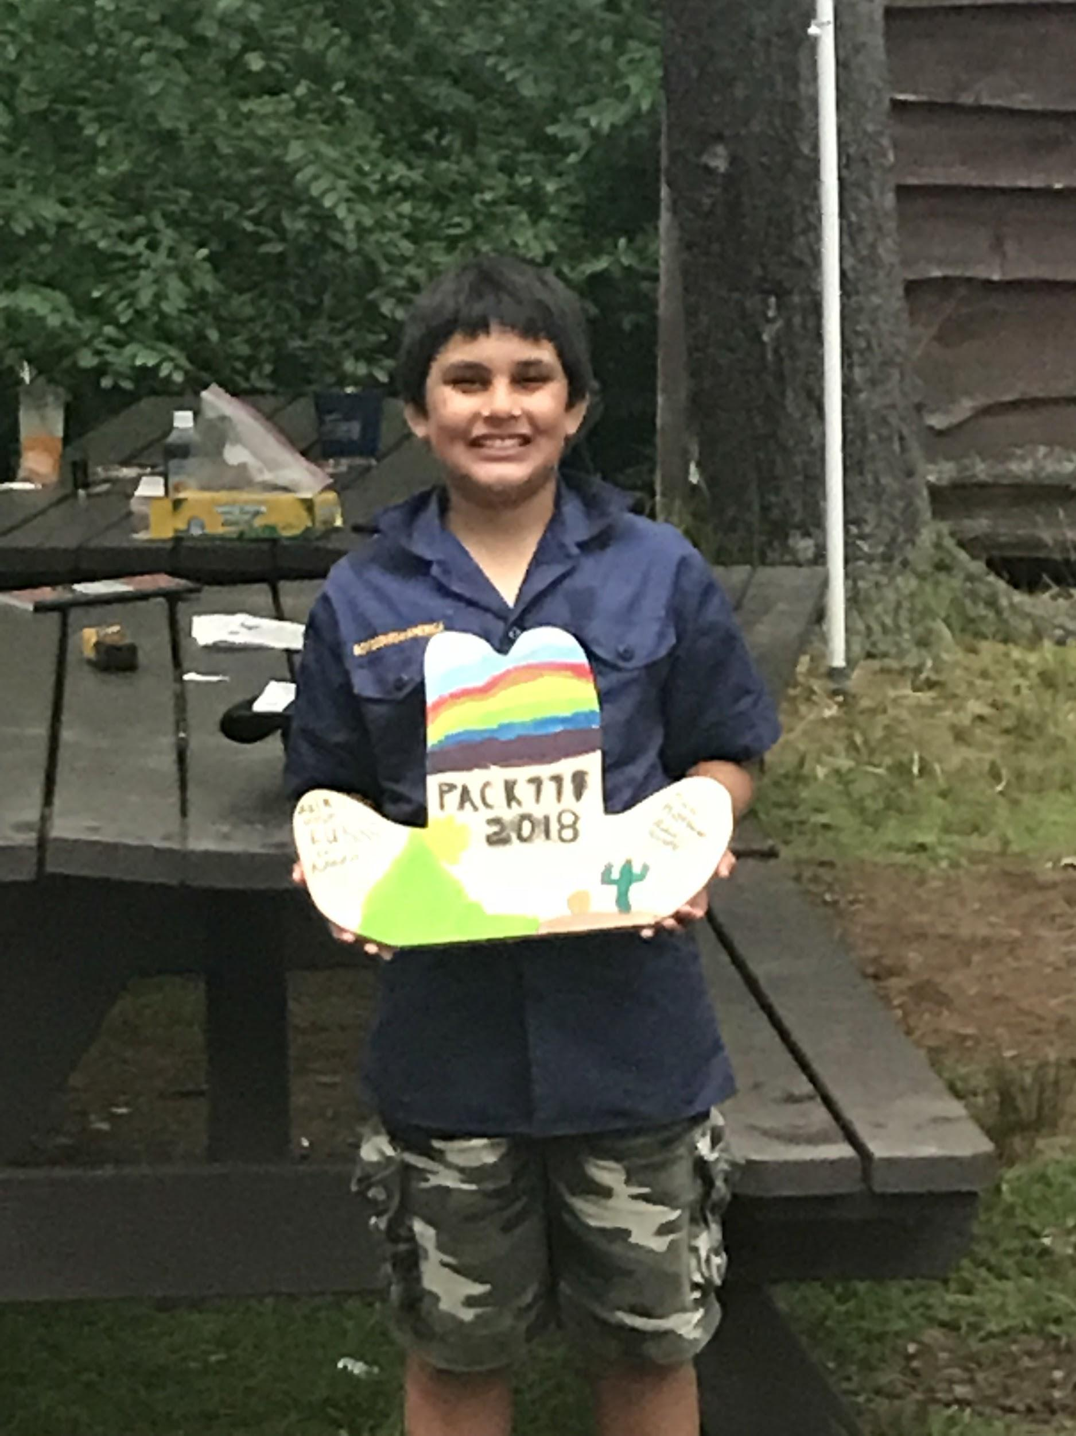
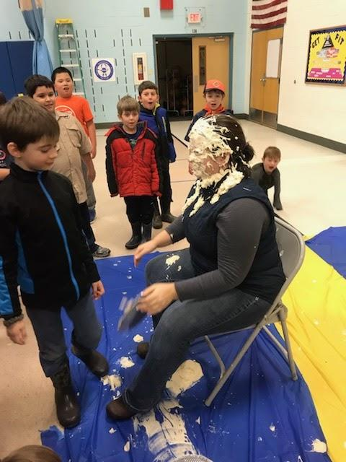
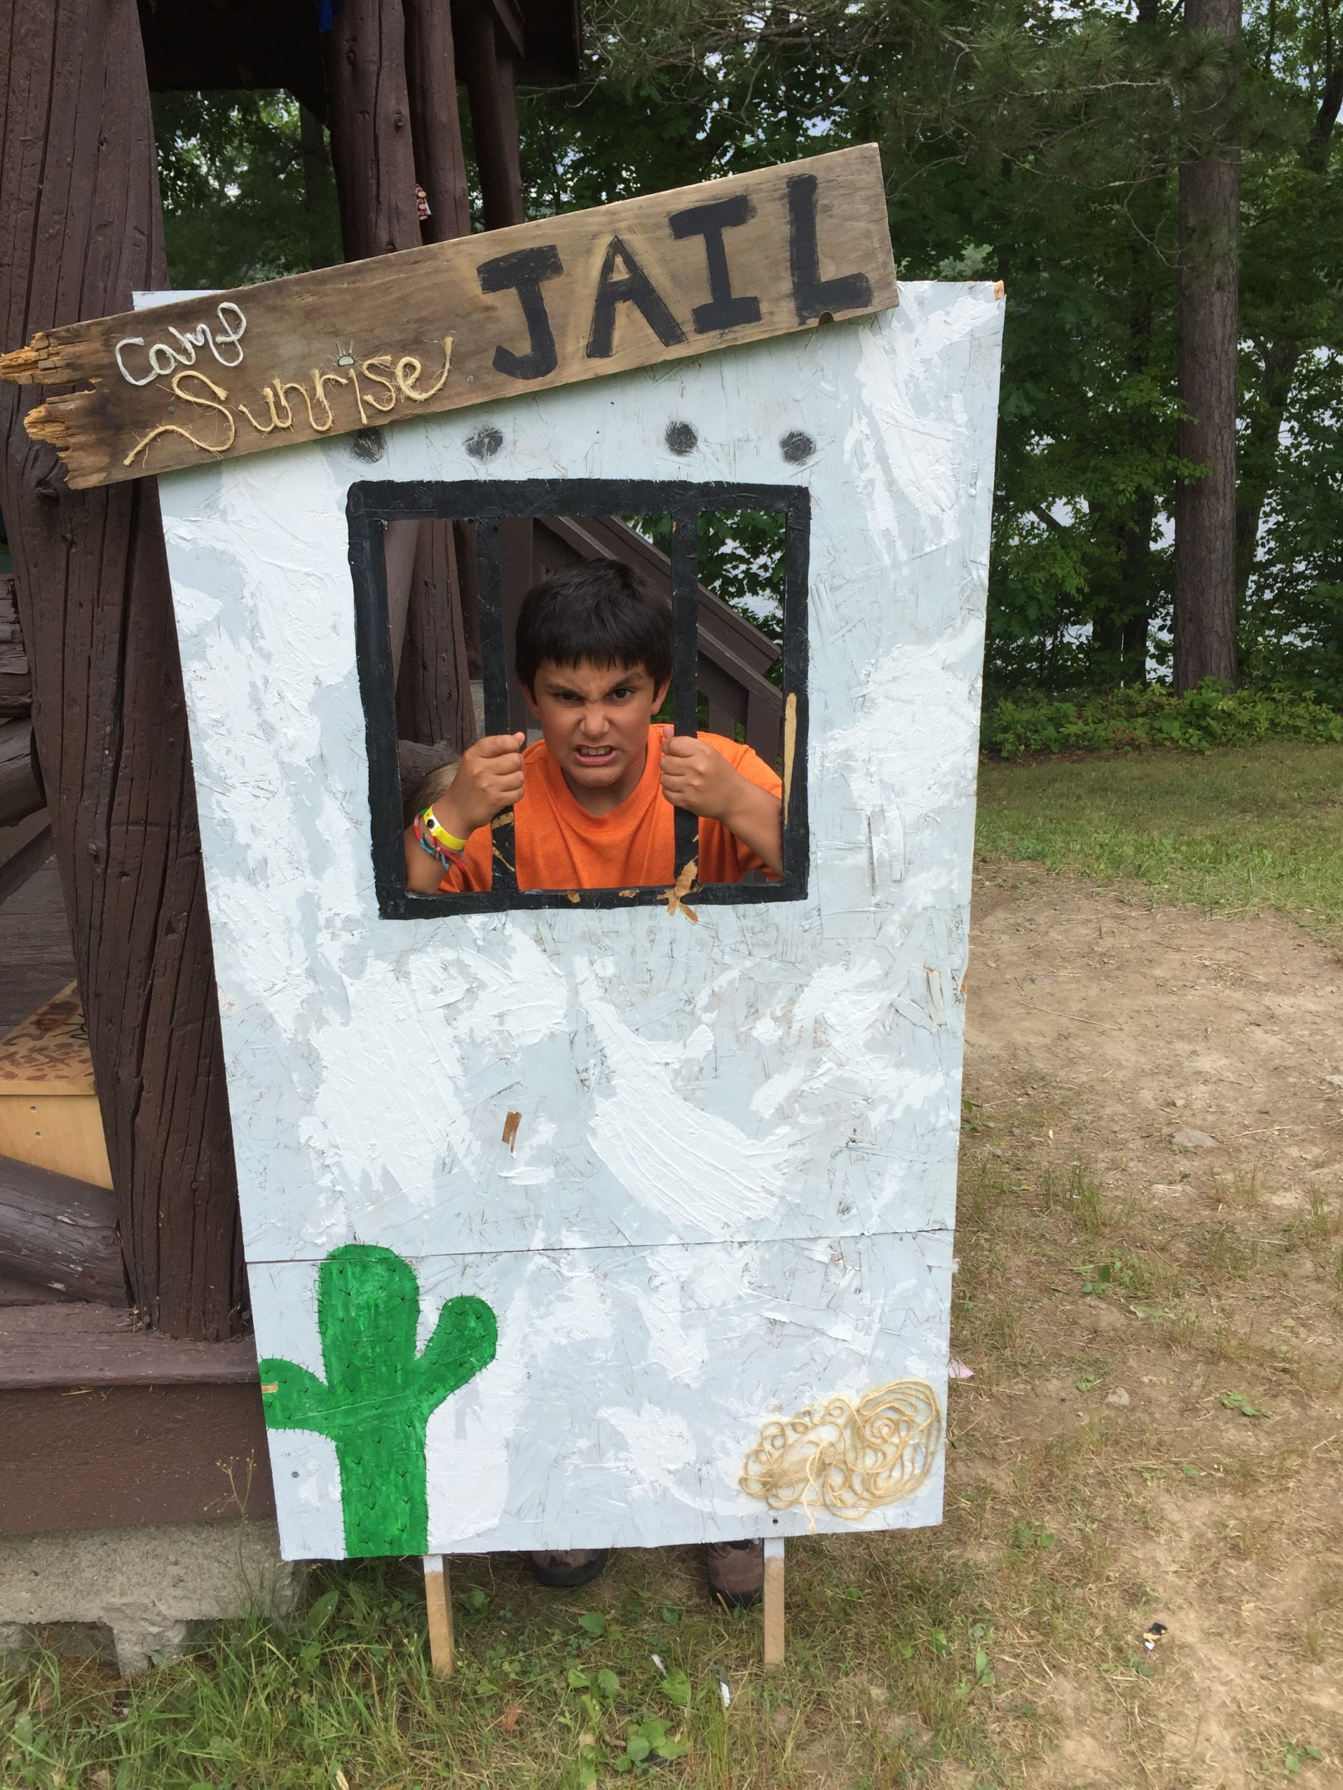
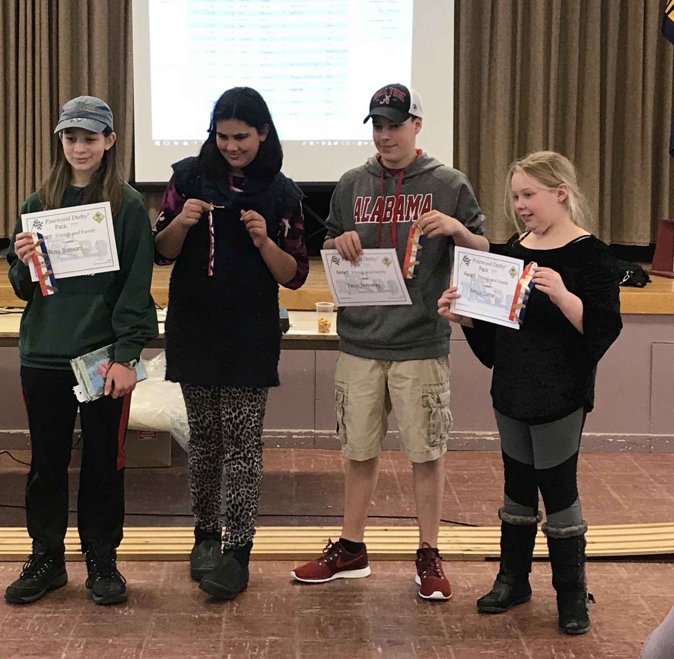

Slide 16


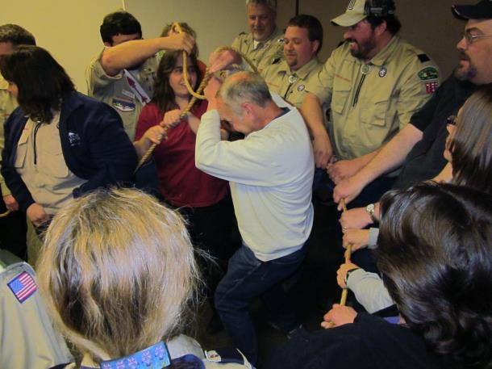
Leader Training
Basic Leader Training for new adult leaders
Youth Protection Training
Monthly Leaders’ Roundtables
Online resources and handbooks
University of Scouting Pow Wow
You Are Not Alone!

Slide 17
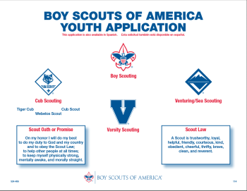
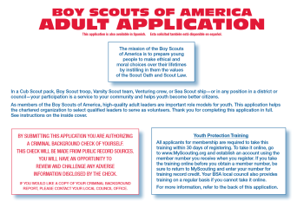
Registration
To register youth:
  Completed form tonight
  Pay Pack Dues - $XX
(Includes registration, insurance, Scout Life subscription
Pack provided patches, neckerchief and slide)
To register adults:
  Completed form tonight
  Take Youth Protection Training online
  Pack covers costs of registration, insurance, training and Scouting Magazine subscription

Slide 18
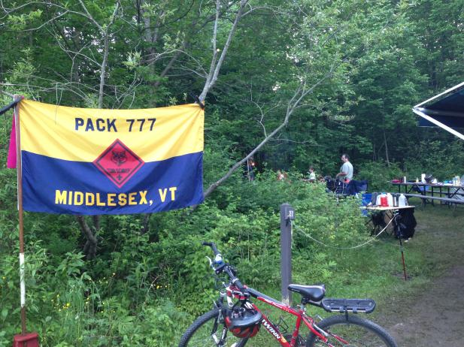
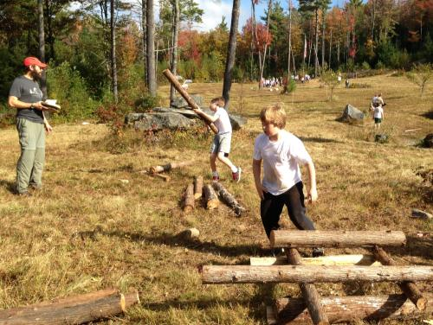
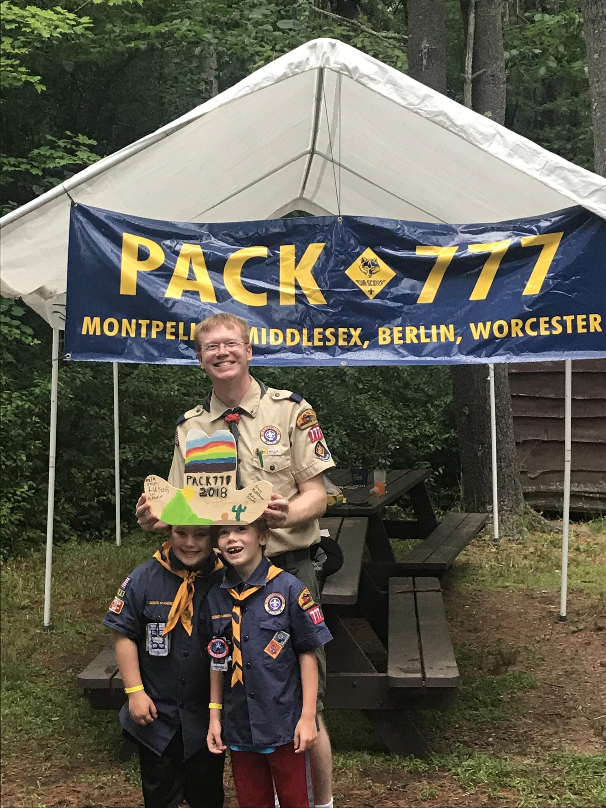
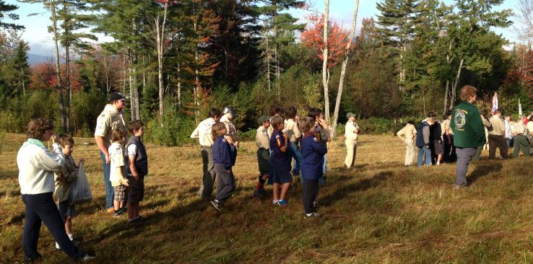

Slide 19
Thank you!
Any questions?
Cubmaster Name
Cubmaster
pack123youremail@gmail.com

Slide 20
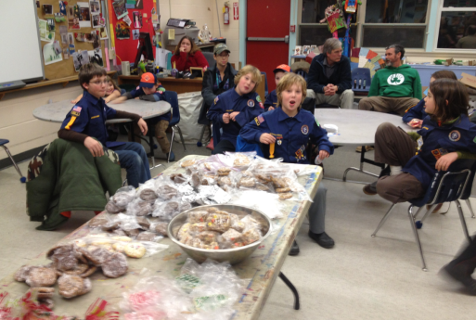
WHAT GIRLS AND BOYS WANT
FUN!
Make new friends
Master new skills
Recognition and praise
FUN!

Slide 21
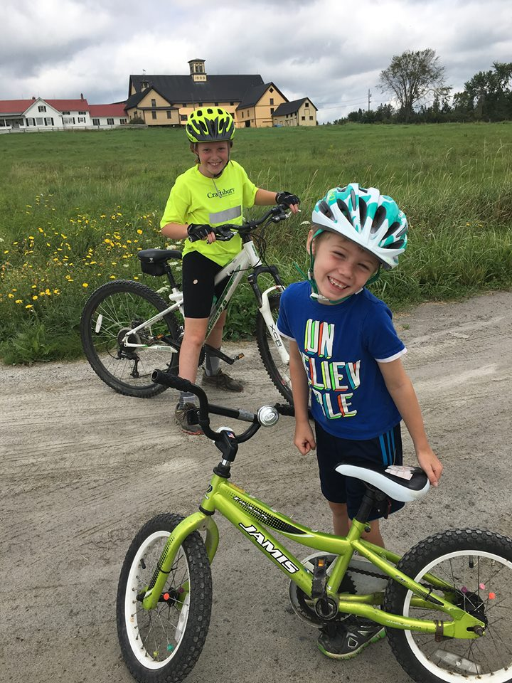
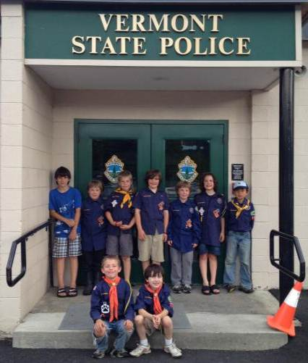
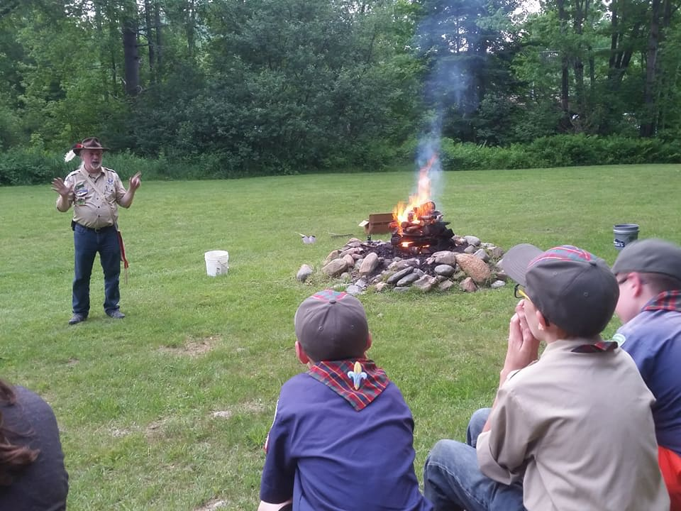
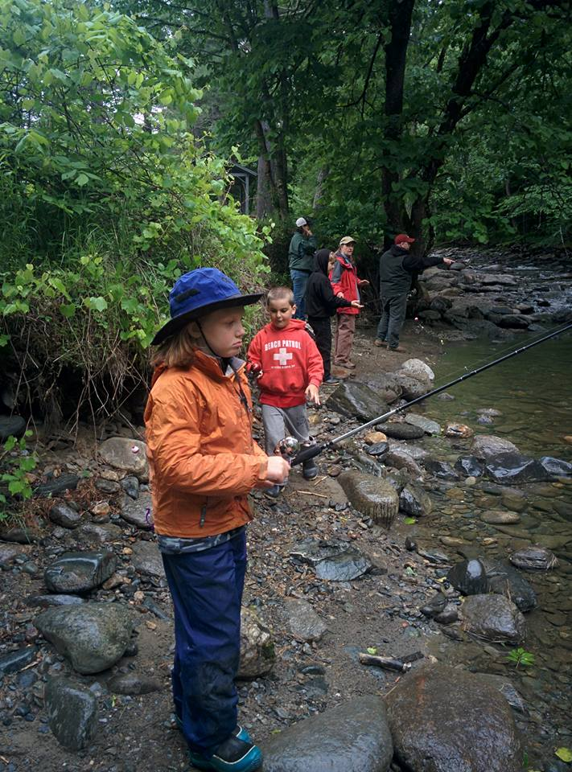
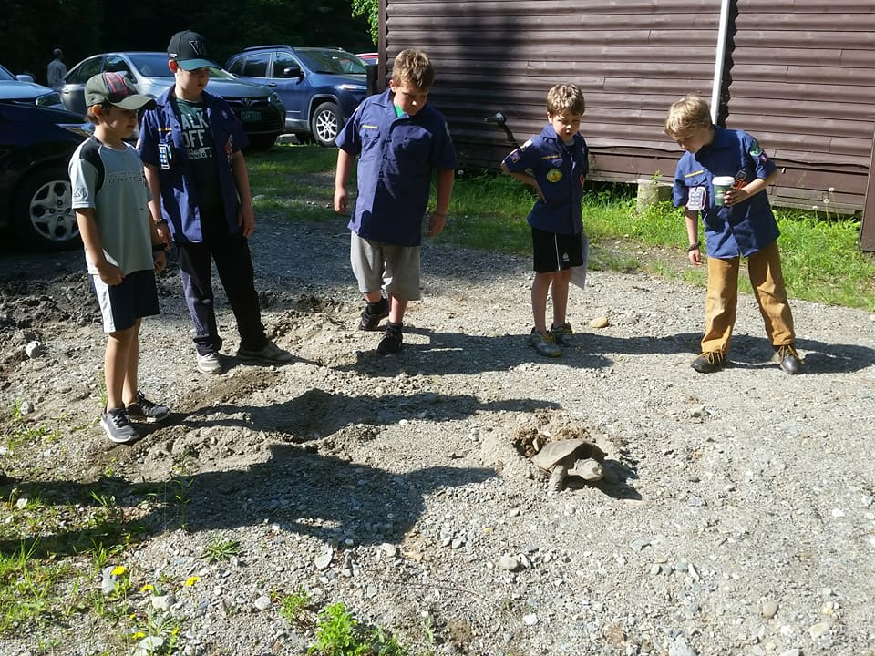
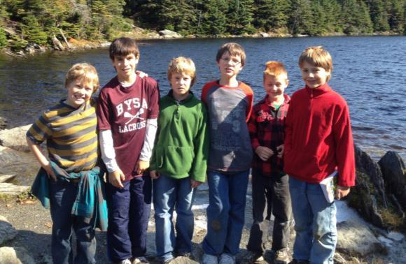

Slide 22
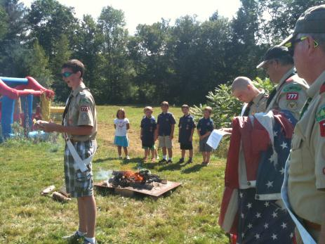
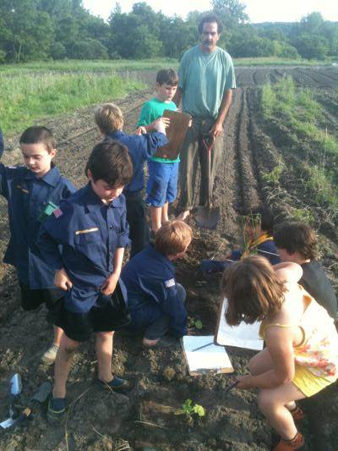
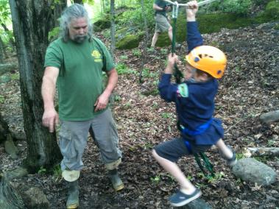
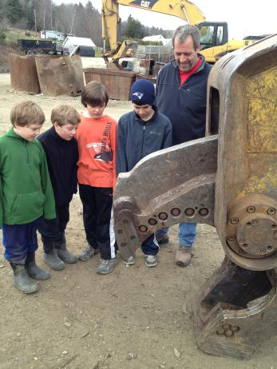
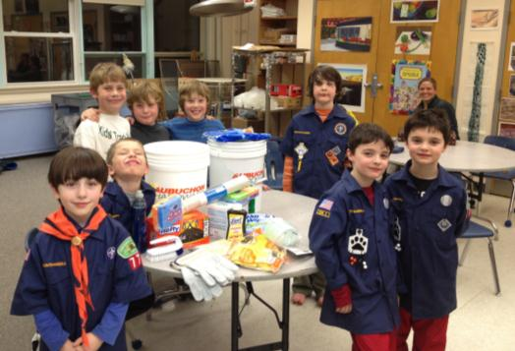

Slide 23
