Slide 1
Welcome
Peanut & Popcorn Fundraiser/Training & Overview 2024

Slide 2
It’s going to be an AWESOME Year !!
This year, our Pack is
planning to:
Activity One Date One
Activity Two Date Two
Activity Three Date Three
Activity Four Date Four
How are we going to do all this fun stuff?
Notes:
Customize for your unit: Add the activities your unit plans to do this year.

Slide 3
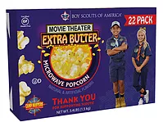
Popcorn Line Up 2024
TEST
$50 & $30 Military Donation
Tasty Trio Tin – 1st time selling spring
3-Way Cheesy Cheese Tin
Chocolate Drizzle Caramel Tin
22 Pack Movie Theater Extra Butter Microwave Popcorn
Supreme Caramel with Nuts
Classic Trail Mix
14 Pack Extra Butter Roasted Summer Corn Microwave
Cinnamon Crunch Popcorn Bag
12 Pack Sweet & Salty Kettle Corn Microwave
Chocolatety Covered Pretzels– 1st time selling spring
White Cheddar Cheese Bag
Caramel Popcorn Bag 10 oz
Purple Popping Corn Jar

Slide 4
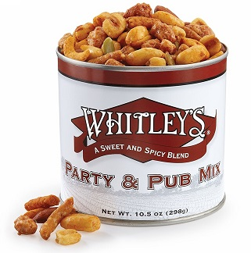
WHITLEY PEANUTS LINEUP 2024
Home Cooked Salted Peanuts 20 oz
Salted Peanuts 12 oz
Honey Roasted Peanuts 20 oz
Honey Roasted Peanuts 12 oz
Jumbo Salted Cashews
Honey Cinnamon Almonds
Whit’s Party Mix
4 Pack Gift Tower
Dark Chocolate Peanut Clusters 10 oz
Milk Chocolate Covered Peanut Clusters 10 oz
Homemade Peanut Brittle
Dark Chocolately Almond Clusters
Notes:
These are the products for the year. You will need to edit the images and prices – each Council sells a different product mix and sets their own pricing. If you need the images, e-mail sean.stanford@trails-end.com and I’ll get them for you. Get through this slide quickly. Focus on any changes and move on. Don’t get bogged down in discussions about flavors.

Slide 5
Keep the Change for Camperships
Customers that say “keep the change” from their popcorn purchase can now help needy Scouts go to summer camp in 2024.

Slide 6
Door Prize!

Slide 7
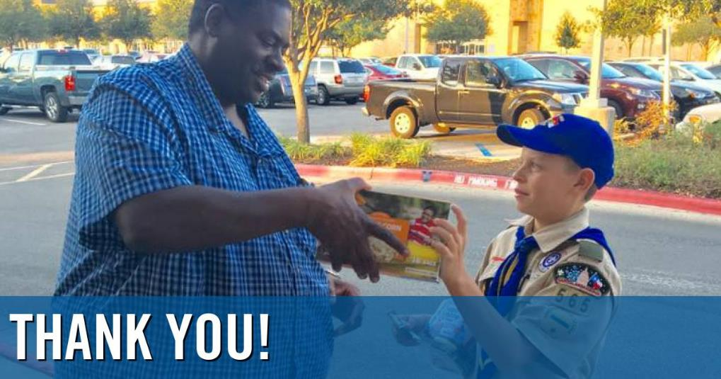
SCOUTS GROW
Character Development
Gain Confidence
Goal Setting
Money Management
Public Speaking
Overcoming fear & rejection
Earn their way…
Notes:
Talk to the parents about WHY we’re selling.

Slide 8
DOOR TO DOOR SALES
Boost your sales!
Sell Door to Door
Sell to Friend & Family
Sell at Work
Sell to last year’s customers
Notes:
Fill in your council’s commission that was paid out. Stress the importance of monies earned

Slide 9
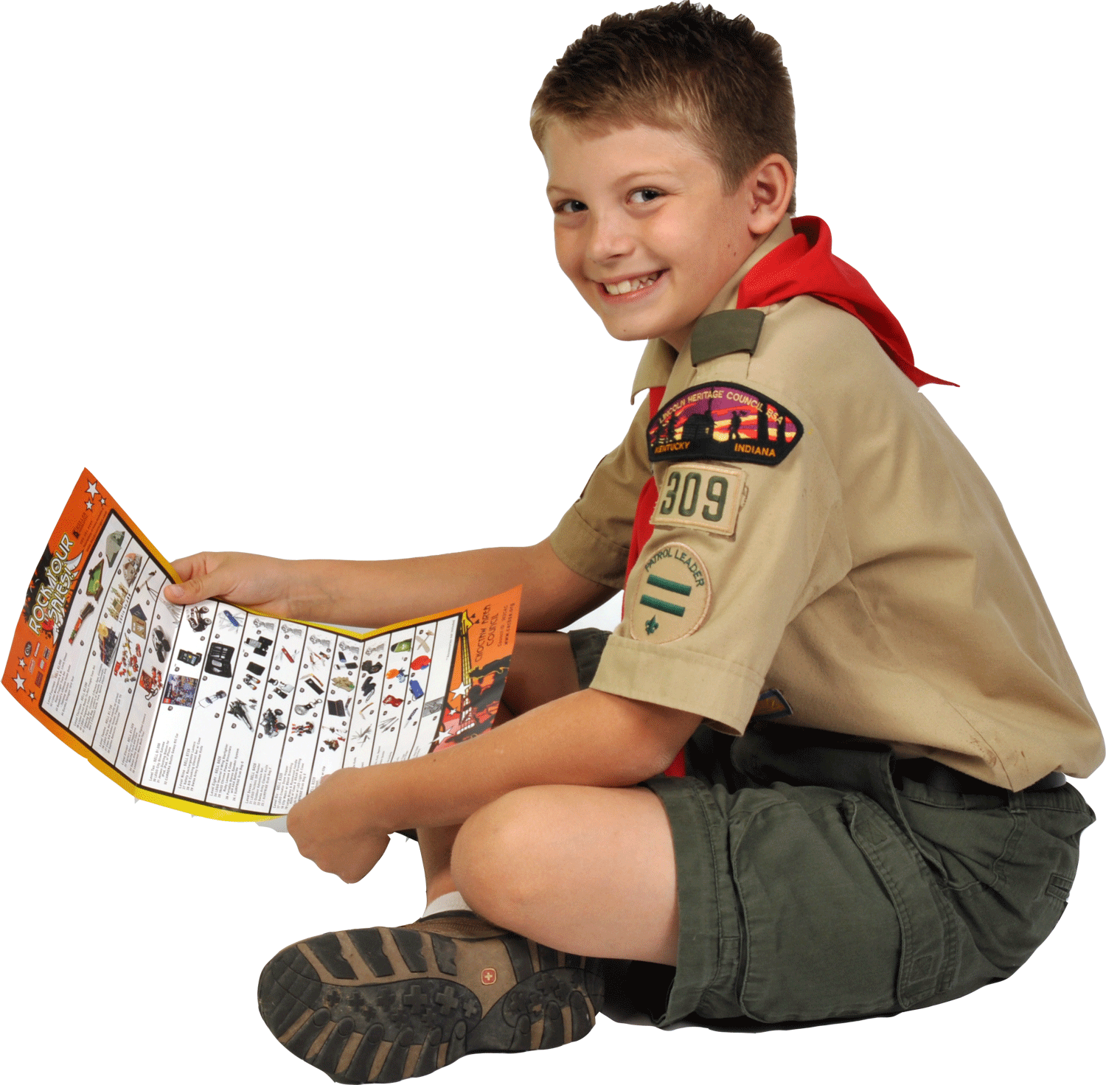
Why CAMP MASTERS Popcorn & WHITLEY’S Peanuts?
You will earn
GREAT PRIZES!!

Slide 10
Prizes!!!
Why CAMP MASTERS Popcorn?
Check out the awesome prizes you can earn by selling popcorn this year!

Slide 11
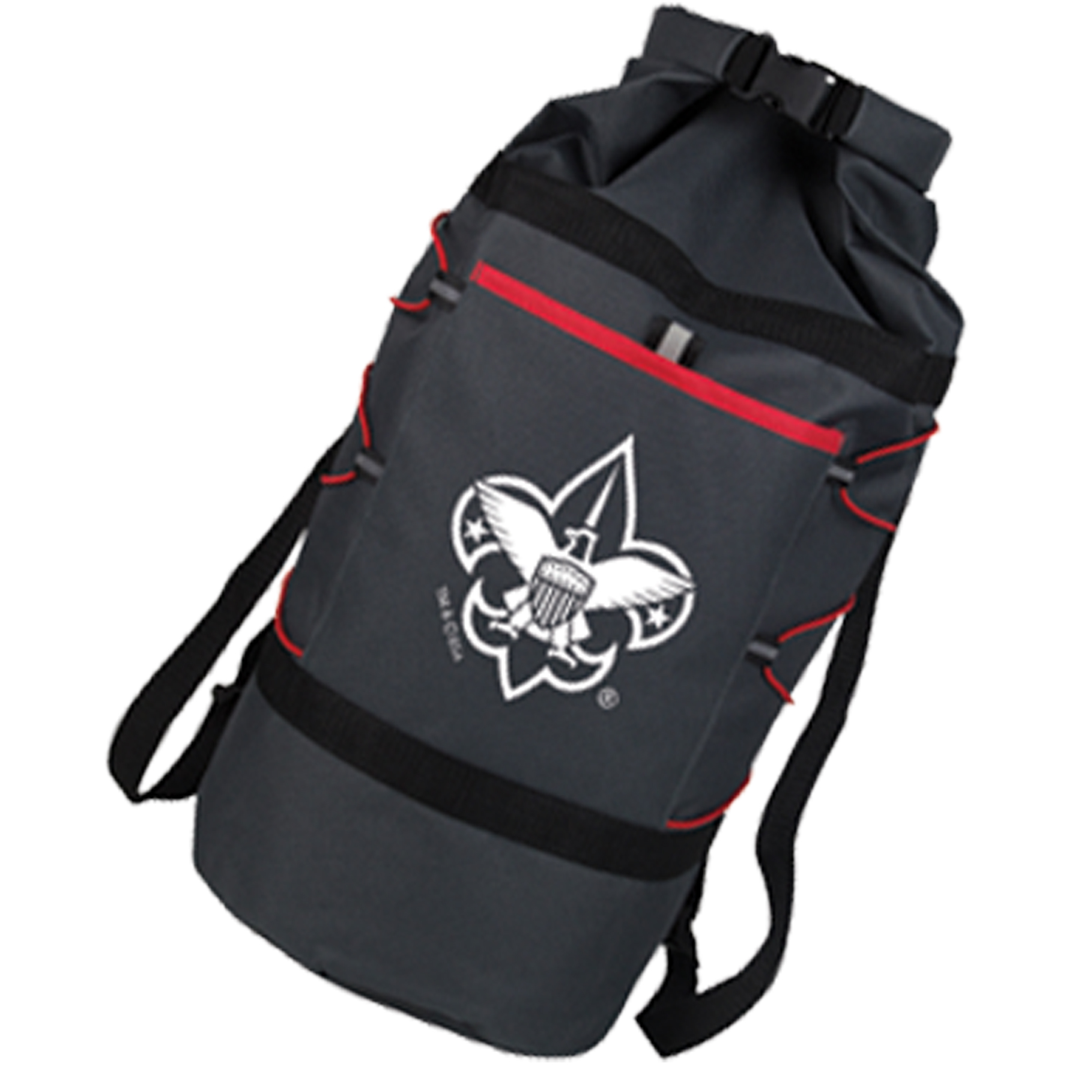
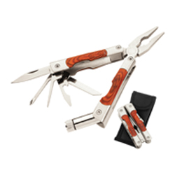
Sell $850
Earn
Hanging Hammock with Hardware
or
Adventure Duffle Bag
or
Rosewood Multi Tool with Case
Notes:
We start building excitement…

Slide 12
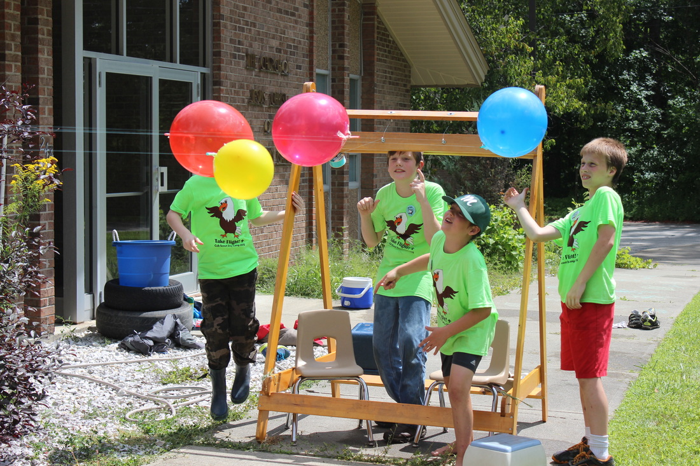
Tips on “Fill-a-Sheet” a little later
Scouts can earn up to $20 towards summer camp! Fill a sheet with Popcorn orders earn $10 Scout Buck & Fill a Sheet with Peanut orders earn $10 Scout Buck
Requirements
Each line on the sheet must be a different household
Copies of full sheets must be turned in by the Unit Popcorn Kernel
Good for use toward Mt Norris Resident camp & Day Camp fees in 2024
Scout Bucks are not transferrable

Slide 13
Thinking of being a Top Seller? Sign the Pledge!
This year, I will be a Top Selling Scout to earn my way and support my Unit and Council. My goal is to sell $2,500 or more and earn my CampMasters High Achievers Prizes . I will follow the Scout Law, and be Trustworthy, Loyal, Helpful, Friendly, Courteous, Kind, Obedient, Cheerful, Thrifty, Brave, Clean, and Reverent. I will always do my best.
Scout Signature: ____________________________
Parent Signature:

Slide 14
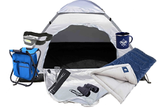
TOP SELLER
A Top Seller is a Scout that sells $2,500 or more in Popcorn. What will you earn for being a Top Seller?
Camp-master Seller Bonus Prizes if Sell over $3,000
If you sell over $3,000 and are the top seller of the Green Mountain Council you will receive a package to the Great Escape Water Park.
Patch & Speciality Pins & $850 Club
Notes:
Show all of the amazing things a Top Seller can earn. A Scout that sells $2,500 in Pack 2017 can get a $150 Gift Card, 6% Schoalrship, Council Campership, 2 Tickets to the Ontario Reign Hockey Game, and the Pack Trampoline Party at Sky High Sports!

Slide 15
Door Prize!

Slide 16
GAME TIME!
Scouts - head outside for some fun popcorn games!
Parents – come sit up front!
Notes:
Send the Scouts Outside with the Cubmaster and a couple of Volunteers. Play Popcorn Games & Identify

Slide 17
Our Sale!!!! Show N Sell & Take Order & Online Our Unit Goal is $______
How to sell…

Slide 18
Use Take Order forms from prior years – Call customers & ask them to buy this year
Drop off order forms at local business with envelope to collect payment – pick up later
Sell at houses of people you know (Neighbors & Family)
Canvas neighborhoods with the door hangers
Put door hanger on door, ring bell and then stand back at least 6 feet
If they answer point to hanger and explain popcorn & peanut sale
Give them opportunity to order immediately and pay at the same time
Or tell them they can mail order.
Always wear uniform
Never sell alone
Sell with parent or one other scout not big group
Never go into anyone’s home; stay on sidewalks or driveways
Wear masks
Use hand sanitizer frequently
Can use fishing pole idea for extending reach
Say THANK YOU!
Be Prepared
Do your Best!

Slide 19
How to sell…
How to sell…
Scout Demonstration
“Hello sir / ma’am, my name is __________,
and I’m a scout with Pack /Troop_____. You purchased popcorn from me last fall, now we are moving our sale to the spring. We’re helping our Pack/Troop raise money for _____. You can help us by buying some of our delicious popcorn or peanuts.
You’ll help us out, won’t you?
Notes:
Invite two Scouts to the front of the room to role play a consumer and selling Scout.

Slide 20
Online Selling Tips
Online sales available for Popcorn Only
Online sales are going to be a bigger part of the popcorn sale this year. Here are a few tips for creating a great impression with your community online.
The most important aspect is the Scout profile it is important to see a smiling Scout face and well composed bios
Work with your Scouts to ensure safety and a good picture
Help them signup through your unit page on CampMasters
Primary online customer family & friends who live far away
Parents can forward to their online contacts too.
Plan on a “sharing” Day that Scout shares online page weekly
Remember product is more on the online sales site
Free shipping to customers
Commission for unit is 29%
Online sales count towards Scout prizes

Slide 21
Sell Online…
Any Scout that sells $400 online will receive a $10 AMAZON Gift Card
All online Scout Sales count towards CAMP MASTERS High Achiever Prizes, Prize Program and Council Prizes
Notes:
Customize for your unit: Use the Popcorn Planner to determine your unit’s sales goals and then the individual Scout goal.

Slide 22
KEY DATES
Take Order sales from April 5th through May 5th
Online sales during these dates count towards the Green Mountain Council Prizes.
Take Order/Rewards Order Due:
Popcorn Pick-Up:
Money Due:
Unit sets date
Unit sets date
Unit sets date
Notes:
Key Dates & Info

Slide 23
CONTACT INFORMATION
John Smith: Popcorn Team Leader
johnsmith@example.com
123-555-5555
XYZ: Popcorn Team Member
Notes:
Provide contact information for key members of your popcorn team.

Slide 24
Thank you

